Slide 1
Transformation from Language Labs to Learning Spaces
Sue E. K. Otto
Director, Language Media Center
Co-Director, FLARE PhD Program in SLA
The University of Iowa

Slide 2
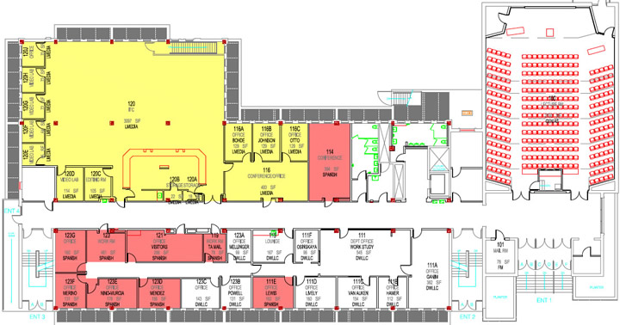
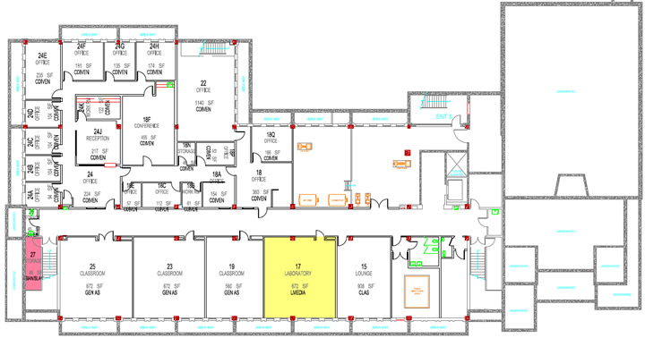
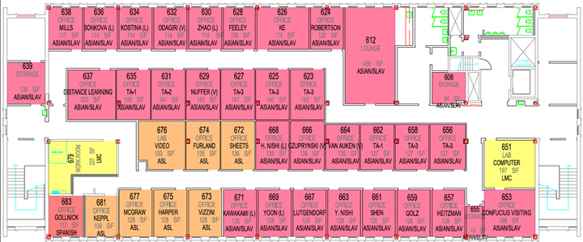
Language Media Center (since 1994)

Slide 3
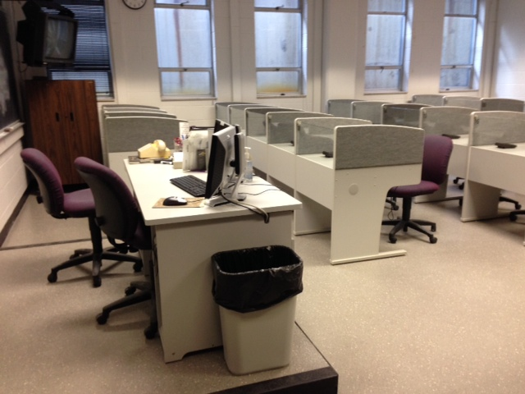
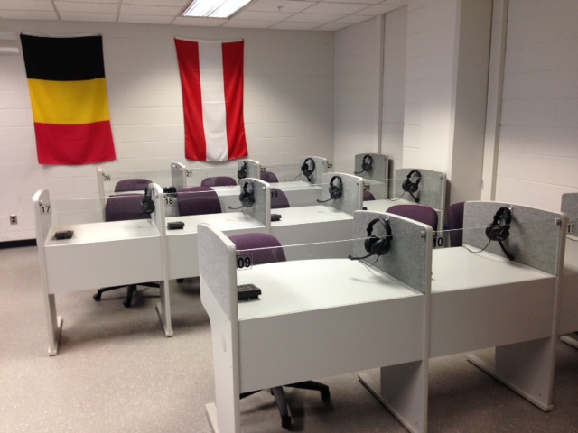
Sanako Lab 100
Notes:
If 10 or even 20 years ago someone had told me that we would still have a language lab classroom, I would have said they were nuts. In 1994 the internet, microcomputers and digital media were already emerging as important factors in language teaching and learning.

Slide 4
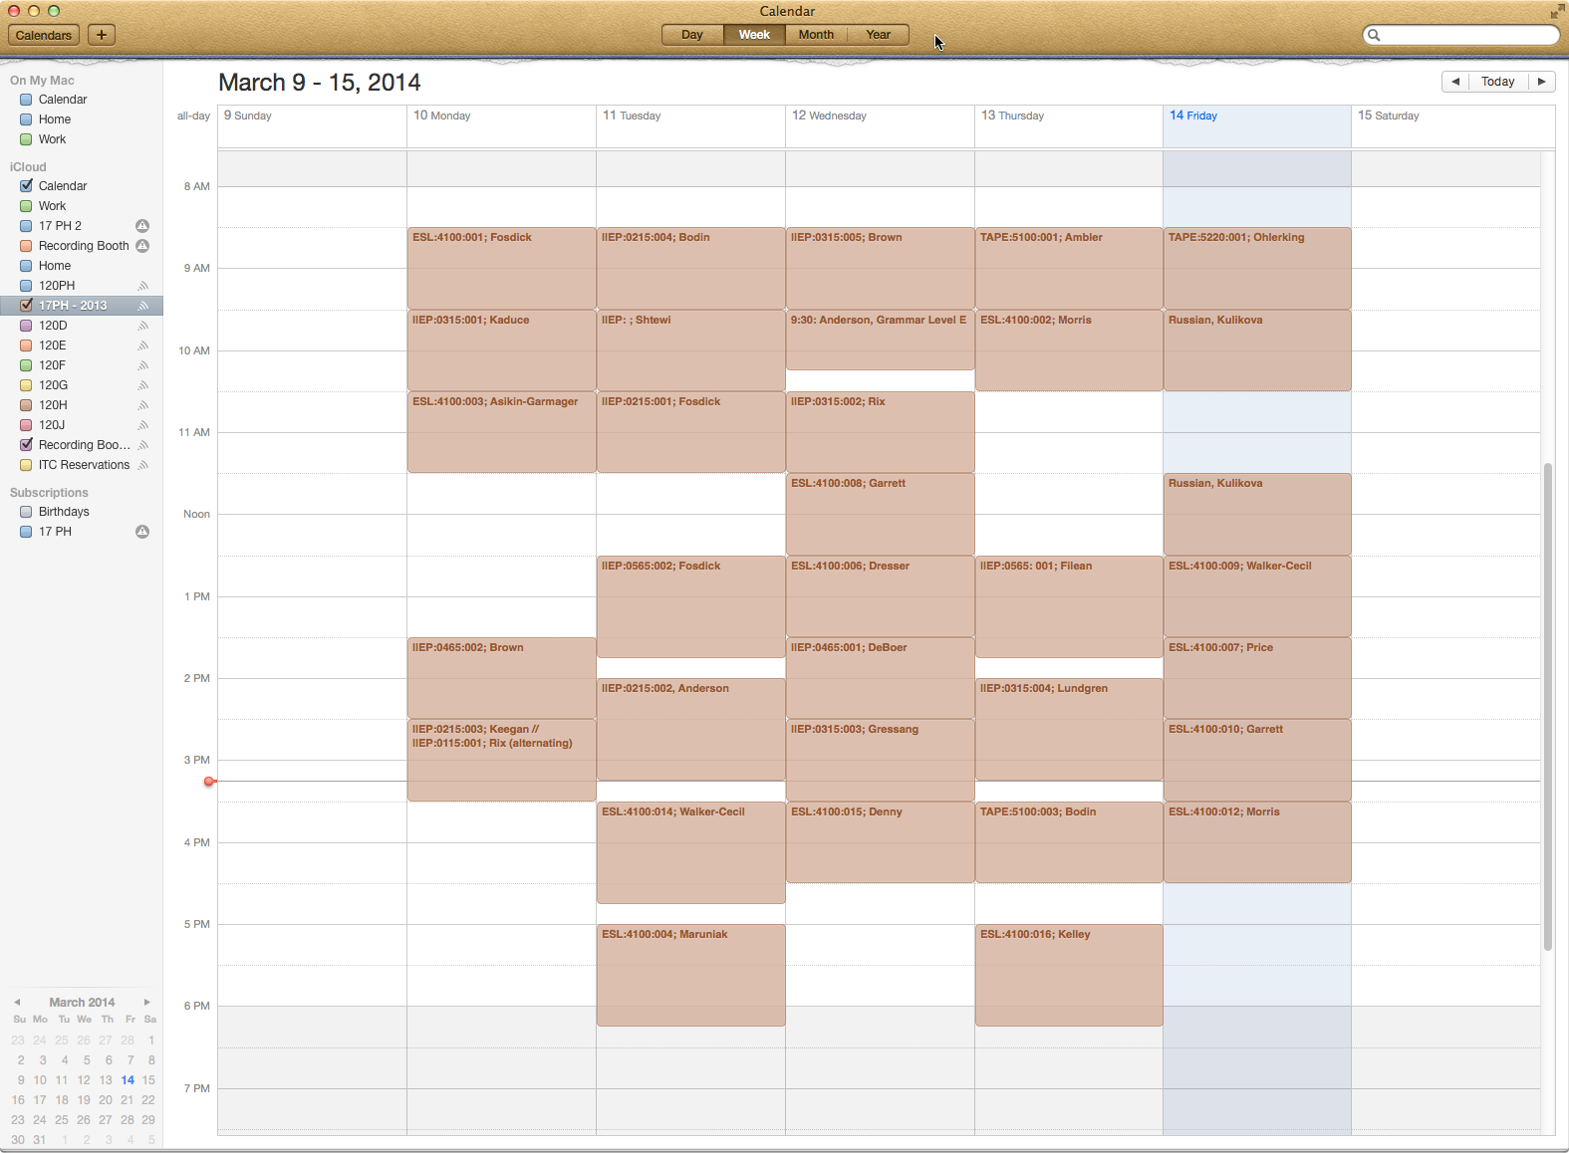
Audio Language Lab

Slide 5
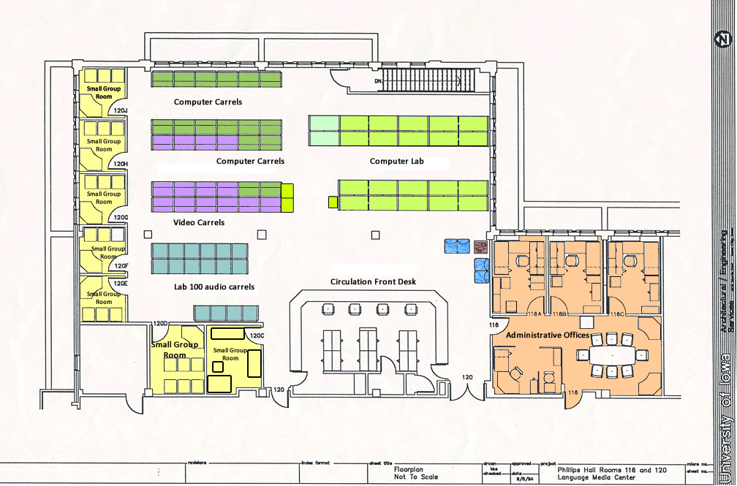
Language Media Center
Notes:
3739 Sq feet in 120 PH; 787sq feet, total 4,526

Slide 6
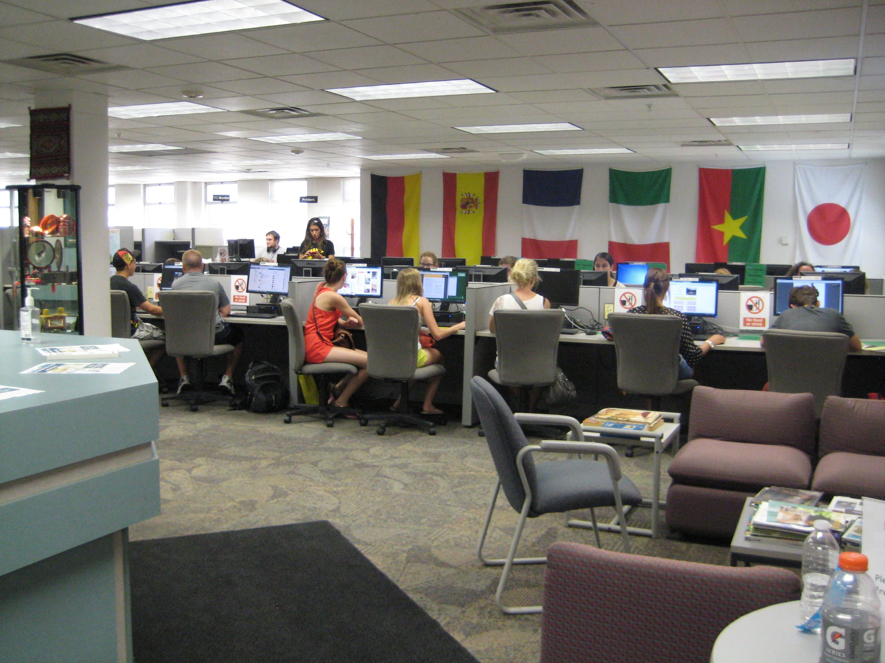
Open Computer Lab
24 Dells, 9 iMacs, 2 Dell express email stations, print release station
Notes:
52 computer workstations – 40 Dells and 12 iMacs

Slide 7
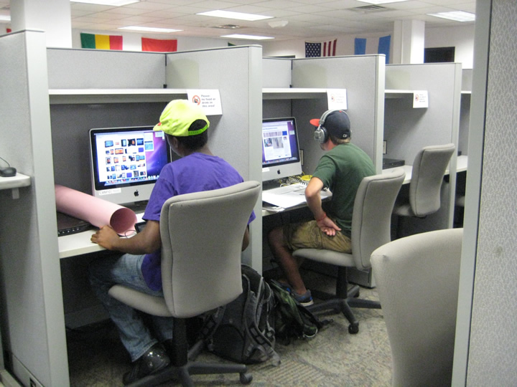
Computer Carrels
3 iMac stations, 13 Dell stations, 4 equipped with scanners

Slide 8
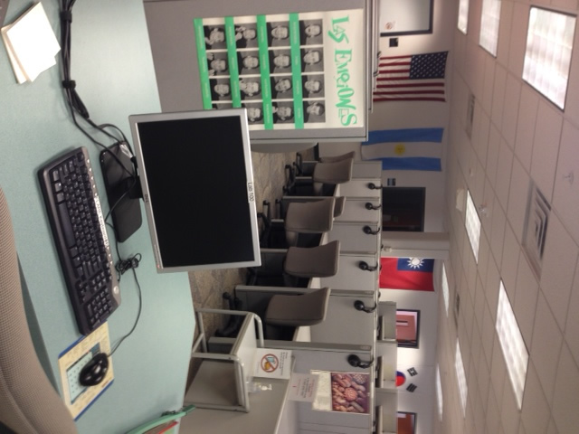
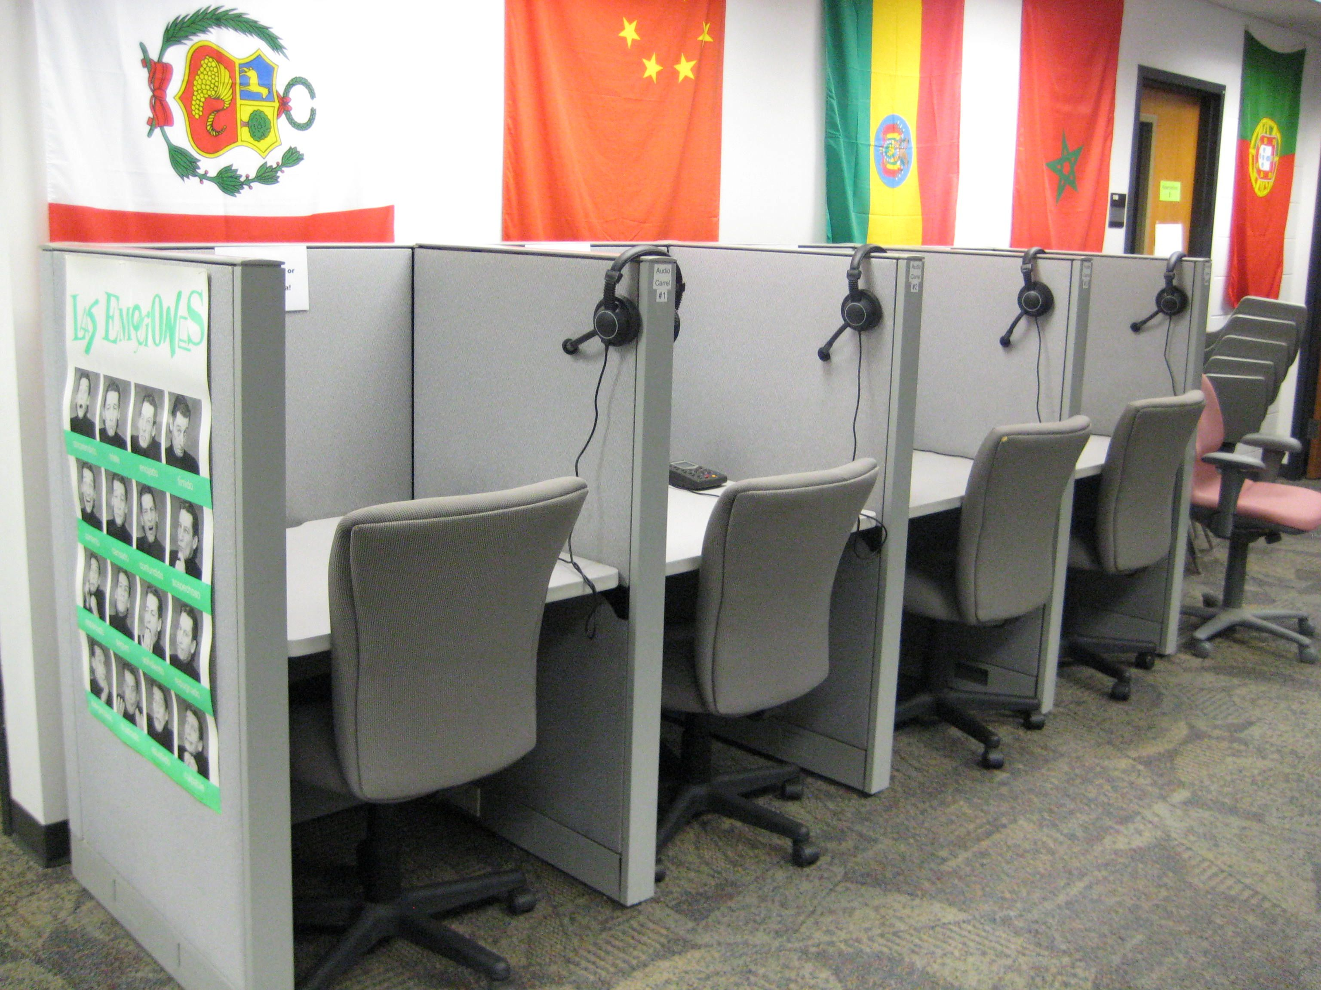
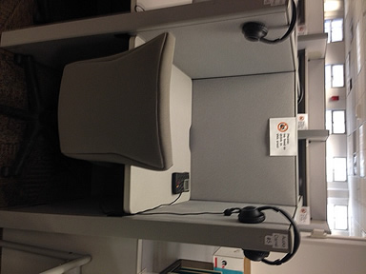
16-position Sanako Lab 100
Teacher computer
Media Storage Unit
Cassette digitizing deck
16 student carrels

Slide 9
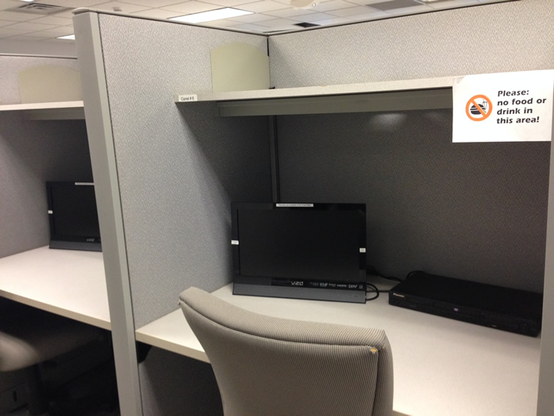
Video Carrels
Monitor
Multi-standard code-free DVD player
(some have VHS cassette players)
Notes:
14 carrels

Slide 10
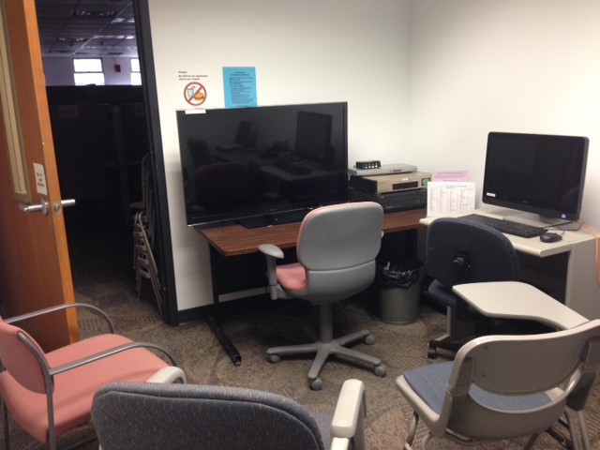
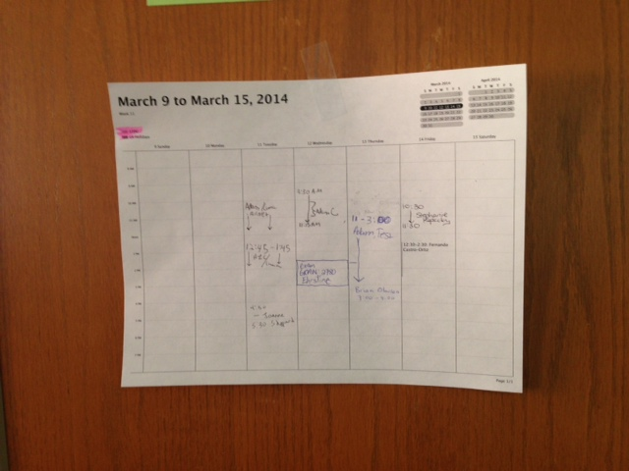
Small Group Rooms
DVD player
Multistandard VCR
Videodisc player
Cable TV
Computer
****
Video viewing
Group work
Conversation practice/testing
Exams
Research data collection

Slide 11
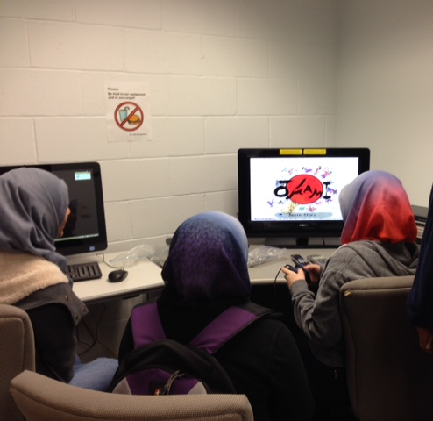
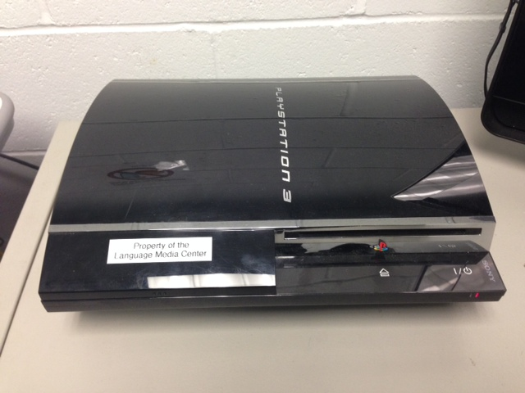
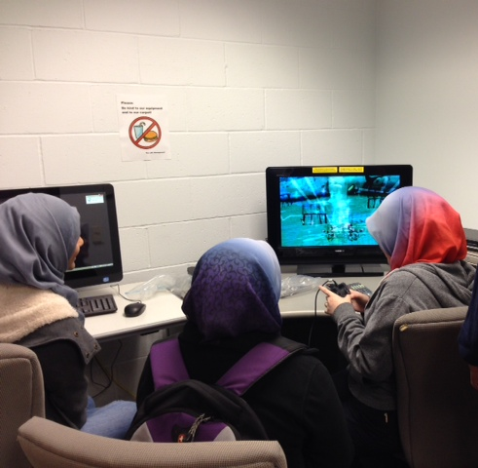
Group Room with PlayStation 3
Notes:
I purchased 2 refurbished PlayStation 3 systems and Japanese video games for a pilot project for the Asian Humanities: Japan course offered this spring. In this course, students follow a number of tropes—vengeful spirits, travelers, and noble failures among them—across the Heian, medieval, Edo, and modern periods. Along the way, they discover that the themes they commonly find in contemporary Japanese manga, anime, and video games often have deep roots. As part of their coursework, students will play Sony PlayStation video games and read corresponding classical texts.
In the first unit of Asian Humanities: Japan, students played the video game Okami, a quest narrative that borrows from the ancient Japanese myths found in the Kojiki, which they read for class. In the first assignment, they were asked to create an argument about modern media appropriations of ancient myths. Many students wrote on whether turning the uneven description of the creation of Japan into a quest narrative could still be considered an adaptation of the Kojiki (most felt it was). Others wrote about whether making major changes to the original source material is acceptable practice (as I should have guessed, most felt it was, and a few claimed it made them want to go back and take another shot at the Kojiki--really?).
In the second unit, students looked at four depictions of warriors in Japan's medieval period: the epic Tales of the Heike, the anecdotes and stories in medieval Buddhist tale collections, the 1953 classic film Ugetsu, and the PS2 video game Samurai Warriors. With the understanding that none of these narratives is considered a history or a realistic depiction of warriors or war, students were asked to write either about how a reading of Heike and other texts from the period influenced their understanding of the later media, or about whether they found one version of warfare to be deeper or more truthful than the others. (Essays haven't come in yet, but most student comments I'm getting are about how hard the game is, and how they keep getting killed--I may get some arguments that Samurai Warriors is the most depressing of the lot ...)

Slide 12
April Fool’s 2006
Notes:
Back then, the thought of hosting the use of popular video games was a joke. But it’s not that way any more.
And the last piece about tearing out the audio carrels and putting in a coffee cart

Slide 13
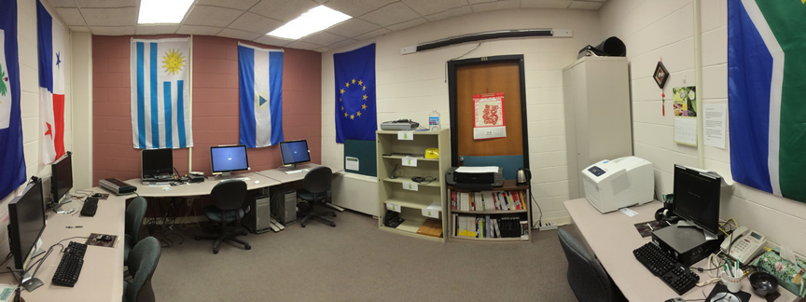
Multimedia Development Studio

Slide 14
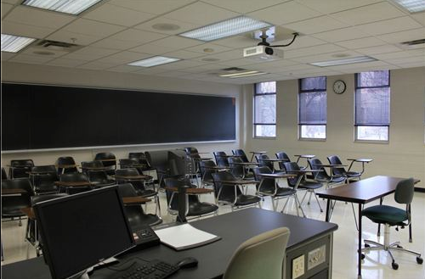
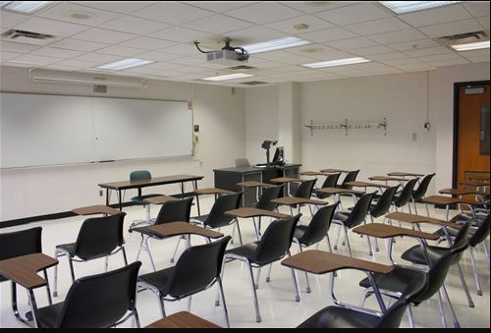
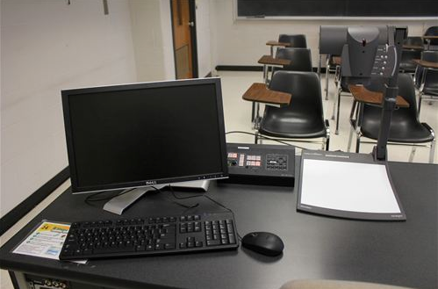
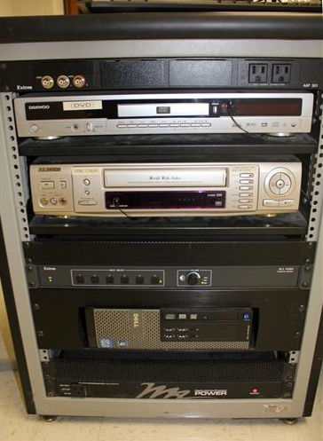
General Assignment Classroom

Slide 15
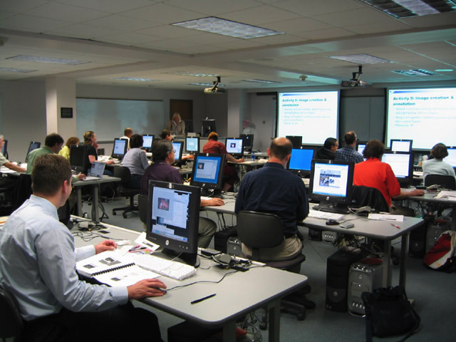
Computer Classroom

Slide 16
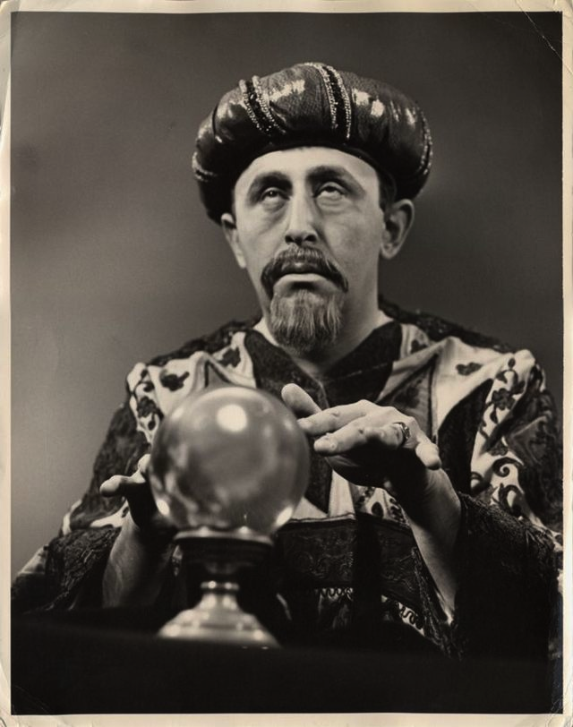
Now to look toward the future…

Slide 17
Educational trends and factors
Education reform
Student-centered, (inter)active instruction
Collaborative activities/tasks
Interactive instruction, exploration
Performance-based assessment
New literacies (needs of digital natives, global citizens)
Approaches to 2nd language teaching/learning (cognitive/psycholinguistic sociocultural)
Notes:
Learning occurs when learners work together with a person/guide/mentor who provides an environment and tools that helps them progress. Fits well with the notion of Student as Creator.
In addition to the traditional cognitive In SLA there has been more emphasis placed on sociocultural theory, in which context and interlocutors are important factors and important tenets include scaffolding and co-creation of meaning and learning materials. Highly participatory.
Cognitive views are grounded in the notion of the autonomous individual - development occurs inside the individuals head; emphasizes universal cognitive change along a natural line
SCT grounded in the notion of the social individual: development occurs at the nexus of the person and the other (also cognitive but cognition is framed in the social context as the stimulus of development); highly variable development favoring a culturally embedded line of development
Both apply to us and what we do.

Slide 18
New Technology-Rich Learning Spaces
Computer workstations
Work areas for mobile devices
Collaborative learning/meeting spaces
Private study areas
Classroom and tutorial spaces
Media viewing spaces
Digital media production facilities (faculty, student)
Soft seating/relaxation for social networking
Notes:
Think zones here in a malleable environment – a shared multi-purpose space.

Slide 19
University of Iowa Learning Commons

Slide 20
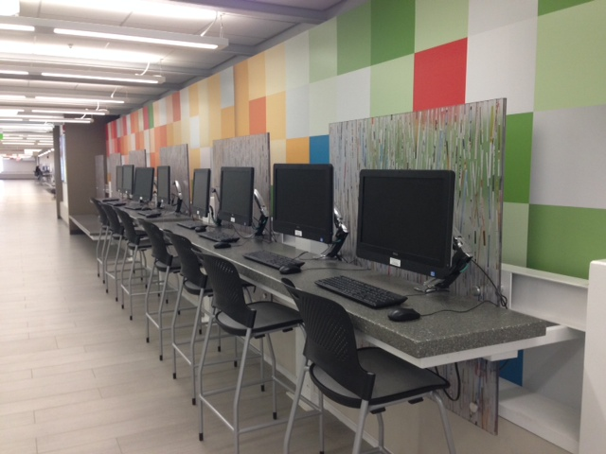
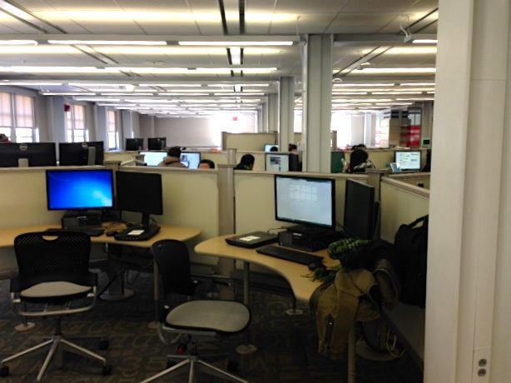
Computer Workstations

Slide 21
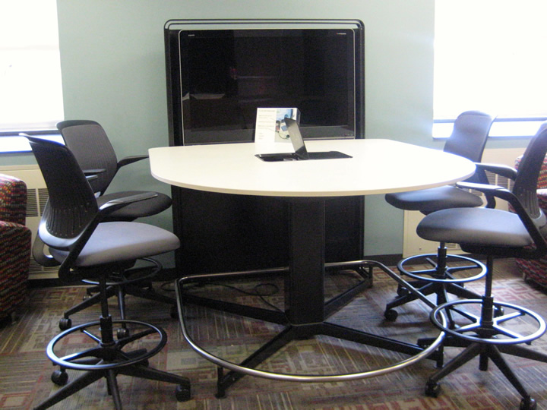
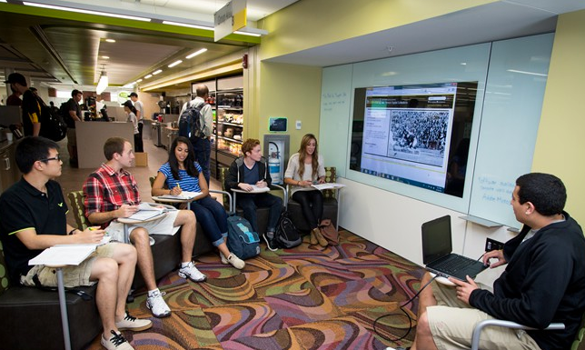
Tutorial Spaces

Slide 22
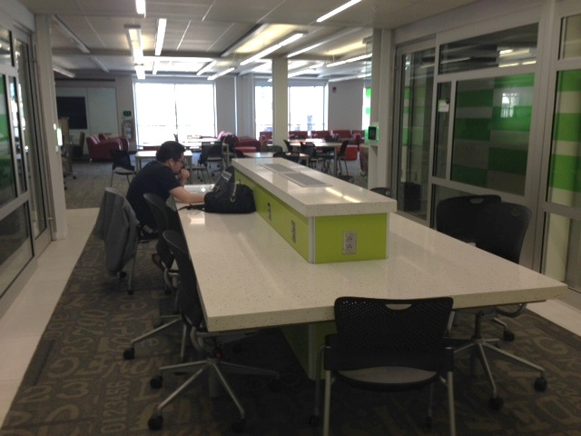
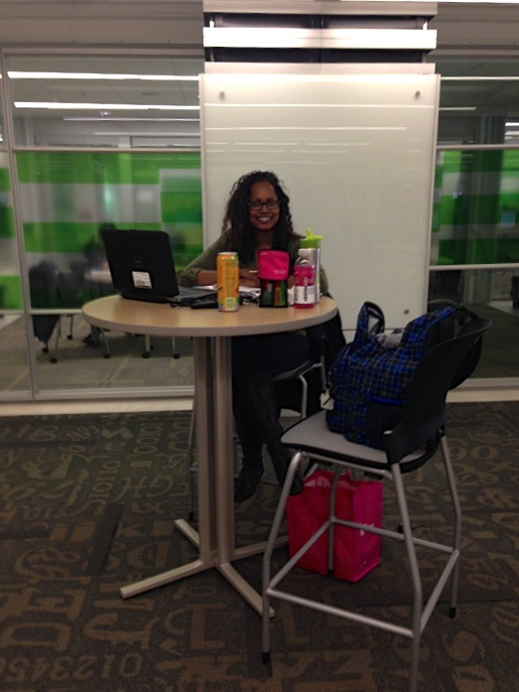
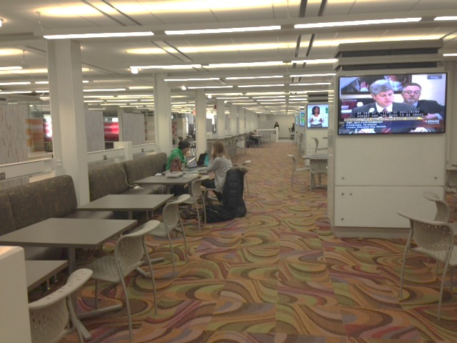
Mobile Device Work Spaces
Notes:
There are a number of zones with a variety of work spaces – and, of course, there is wireless internet access everywhere.

Slide 23
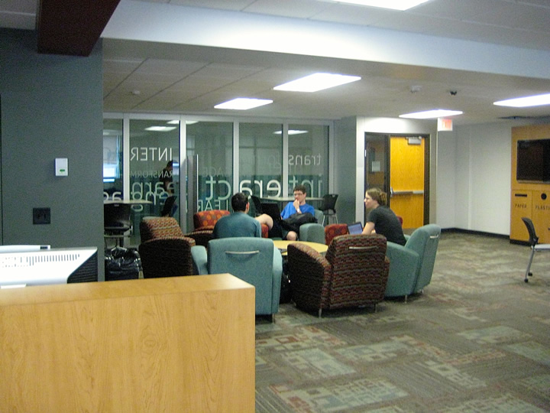
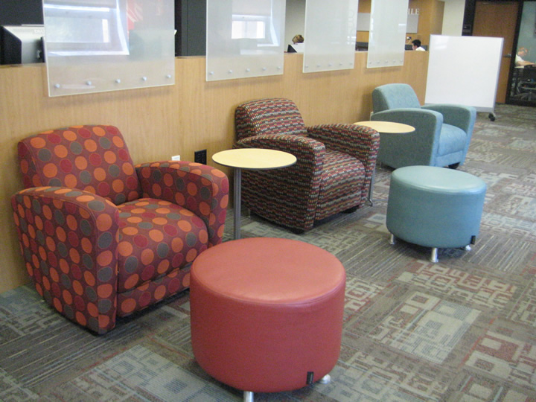
Soft Seating
Notes:
These arrangements work for meetings and individual study in comfort. Relaxing.

Slide 24
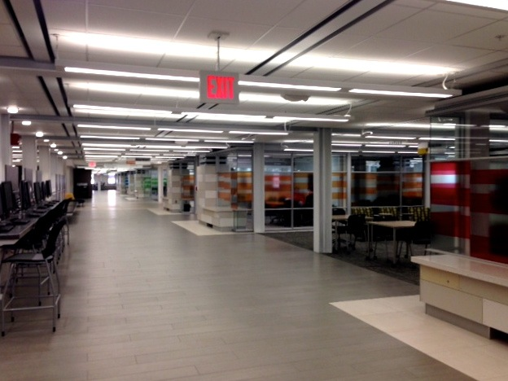
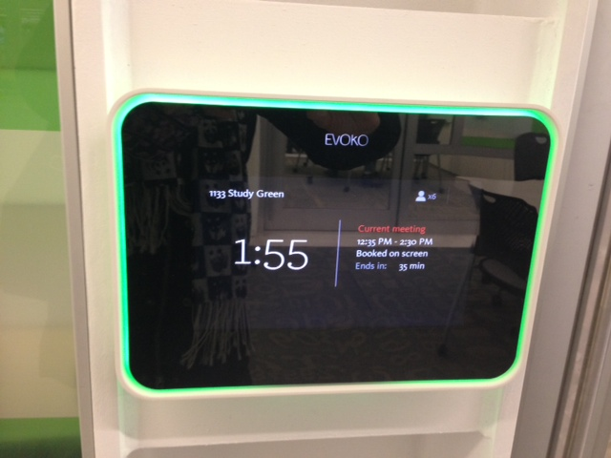
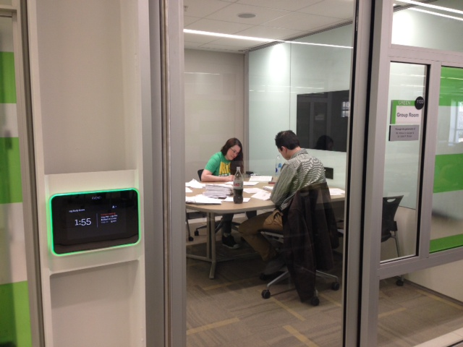
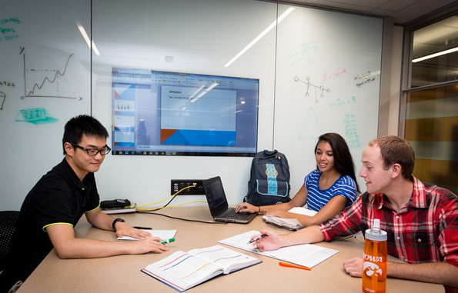
Group Rooms Redesigned

Slide 25
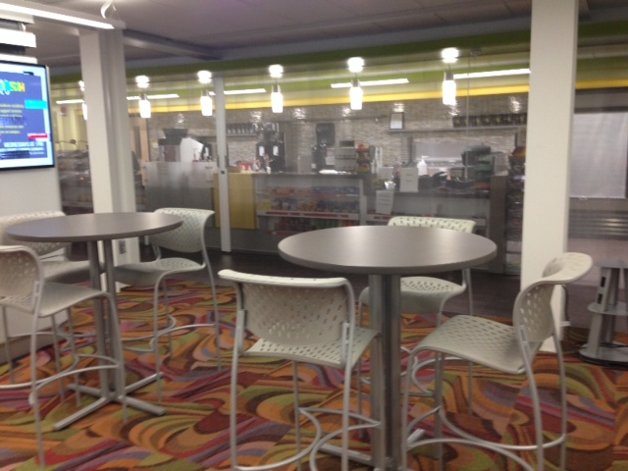
Food for Thought Café
Notes:
Casual setting for networking, taking a break

Slide 26
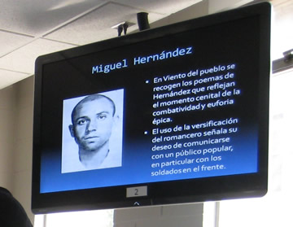
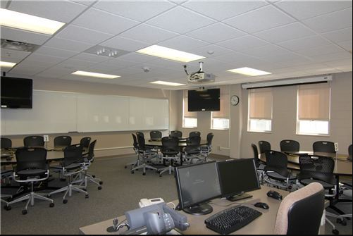
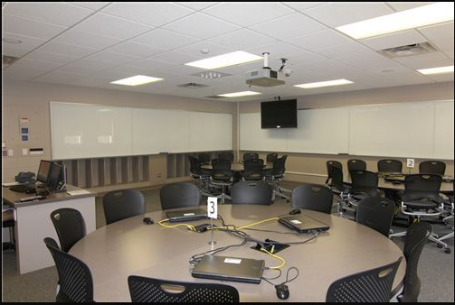
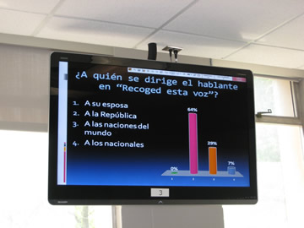
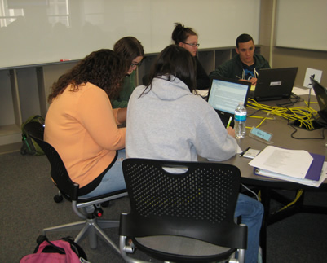
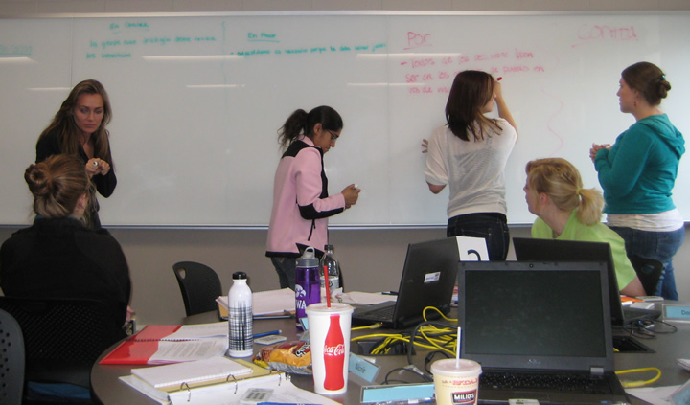
TILE Classroom
Notes:
This is the classroom Environment that fosters student-centered learning. Focus on collaborative work and active learning techniques with technology. We have 7 faculty in the Division of World Languages, Literatures & Cultures who regularly teach in one of these rooms.

Slide 27
You can build it, but they won’t come unless you have:
Committed, innovative, tech-savvy faculty
Support personnel to provide:
Consulting and training (focused on technology and language learning/teaching)
Development assistance
Oversight and renewal of tech infrastructure
Troubleshooting and help for users on site
Resources to support continued innovation

Slide 28
Questions or comments?

