Slide 1
CALL and New Media Literacies
WorldCALL 2013
Dr. Sue E. K. Otto
University of Iowa
Notes:
Although CALL appears in this title, it is my strong conviction that this term will fade away and our focus will be back where it should be on language learning. We are fast approaching a time when everything we do is facilitated by computers and digital technologies. Just as we didn’t ever refer to chalk-assisted instruction, we will no longer refer to computer-assisted instruction.

Slide 2
Education Reform for the 21st Century
Conventional
Teacher-directed
Teacher as knowledge dispenser
Didactic teaching
Individual work
Ability groupings
Assessment of factual knowledge and discrete skills
Reform
Student-centered
Teacher as facilitator and mentor
Interactive instruction
Collaborative work
Heterogeneous groupings
Performance-based assessment
From Using Technology to Support Education Reform, a report by Means et al. for the U.S. Department of Education, 1993.
Notes:
http://www2.ed.gov/pubs/EdReformStudies/TechReforms/index.html

Slide 3
ACTFL Partnership for 21st Century Skills
In the past
Teach about the language
Teacher as presenter
Focus on isolated skills
Language learning confined to classroom
Homework turned in to the teacher
Today
Learn to use the language
Learner as doer and creator
Focus on modes: interpersonal, interpretive, presentational
Provide opportunities for learners to use language outside of classroom
Learners create to share and publish for others besides the teacher
From 21st Century Skills Map, Partnership for 21st Century Skills, http://www.p21.org/.
Notes:
Isolated skills: reading, writing, listening, speaking
Interpersonal mode: active oral or written communication where participants negotiate meaning to make sure message is understood
Interpretive mode: ability to listen or read and interpret the meaning
Presentational mode: one-way communication - written or oral communication in which the presenter must take into account the impact on the audience
Departs from the traditional view that education and learning take place primarily in the classroom.

Slide 4
Instructional Goals: Wesch (2009): move from knowledgeable to knowledge-able
Focus on how, not what:
How to communicate
How to observe and participate
How to inform oneself: look for, evaluate, and interpret/analyze information
How to create and share information in many formats
Notes:
The education reforms cited on the last slide bring into focus the change in instructional goals from an emphasis on what to and emphasis on how.
Kansas State University professor Michael Wesch calls this change from knowledge to knowledge-able. (HOT = Higher Order Thinking Skills (active learning – immediate application, practice by doing) LOT = Lower Order Thinking Skills (passive learning through hearing or reading). We can talk about this from several angles and I have a couple of examples that will illustrate a shift away from a focus on “what” toward a focus on “how”
Growing autonomous learners.
We can add “interculturally” to all of these.
We can’t possibly teach students everything in the amount of time that we have with them. So, it’s not a matter of teaching content - facts and information – and assessing recall of that content, but rather teaching how to learn – how to communicate, to observe, to evaluate and to interpret. This is especially true when they are in contact with people from other cultures. This is also how we prepare life-long learners - life-long learners who are true cyber-sophisticates, able to interact with people in other cultures in other languages.

Slide 5
L2 Instructional Goals:
Focus on how, not what:
How to communicate in the L2
How to observe, understand and participate competently in L2 communities
How to look for, evaluate, and interpret/analyze information from authentic L2 sources
How to create and share information in many formats with an understanding of its cultural dimensions
Notes:
Read, write, listen, speak – comprehend and produce
Build intercultural competence
Gather and evaluate authentic L2 media
Create and share information with an understanding of how it reflects ones own culture.

Slide 6
The focus on “how” translates into a need for new media literacies.
Notes:
So what do we mean by new media literacies and how did we get from “literacy” to plural “literacies” anyway? In this part of the presentation, I will introduce you to some of the literature that is available about literacies, most of it situated outside the specific domain of language learning and teaching.

Slide 7
Literacy
The condition or quality of being literate, especially the ability to read and write.
Notes:
Literacy has traditionally been described as the ability to read and write. In some updated definitions, it also included the ability to do arithmetic as the third of the basic survival skills needed to function in society. But the meaning of that term has been elaborated in recent years as evidenced by the topic of this presentation – New Media Literacies,

Slide 8
Information Literacy
Skills needed to find, retrieve, analyze, and use information that include the abilities to:
Determine the extent of information needed
Access information sources effectively and efficiently in many formats
Critically evaluate information and sources
Use information to achieve a specific goal
Understand the legal and social issues involved in using information and making ethical and legal use of it
Association of College and Research Libraries
Notes:
From ACRL’s Information literacy competency standards for higher education.
Information literacy is the solution to Data Smog.
In the next slide I will show you a video that amplifies a bit on this definition in a lively and colorful fash

Slide 9
The fact that information literacy is applicable in all disciplines, involves metacognition, and is a way of thinking combined with a set of skills, hampers its inclusion in a methodical way in college curricula. It doesn’t "belong" to any single discipline, but instead belongs to all of them.
(Weiner, 2010)
Notes:
As we have moved from teaching students about the language toward developing students as active speakers and users of the language, literacy has become critical.

Slide 10
New Media Literacies (MIT Style)
Notes:
Video is not intended for foreign language educators, but everything they say is relevant to us and our broad mission in language and culture.
As you can tell from listening from this movie, there are a lot of variations of the term “literacies” plural. Here they term them “media literacies” – but they really include visual literacy, cultural literacy, and information literacy in their use of the term.

Slide 11
New London Group: 4 components of the pedagogy of multiliteracies
Situated Practice
Immersion in experience and utilization of available discourses
Overt Instruction
Systematic, analytic, and conscious understanding that students shape or design based on their experiences
Critical Framing
Interpreting the social and cultural context of particular designs of meaning (taking a critical view of what they are studying in relation to its context).
Transformed Practice
Transfer in meaning-making practice (putting the transformed meaning to work in other contexts or cultural sites)
Notes:
The New London Group was a team of 10 academics who were concerned how literacy pedagogy might address the rapid change in literacy due to globalization, technology and increasing cultural and social diversity Pedagogy is a complex integration of 4 factors: Situated Practice, Overt Instruction, Critical Framing and Transformed Practice.
Like others, they view literacies as embedded in social, cultural and material contexts and that human knowledge is initially developed through collaborative interactions with others of diverse skills, backgrounds and perspectives joined together in a specific epistemic community.
Critical framing takes into account the examination of how all kinds of media contribute to or limit the act of communication.

Slide 12
Students as Global Citizens
Information Literacy
Media Literacy
Technology Literacy
Able to access, manage, and effectively use culturally authentic sources in ethical and legal ways.
Able to evaluate authentic sources to understand how media reflect and influence language and culture.
Able to use appropriate technologies to interpret messages, interact with others, and produce written, oral and visual messages.
21st Century Skills Map: World Languages (2011), Partnership for 21st Century Skills
Notes:
Information literacy: informed global citizens who are able to access, manage, and effectively use culturally authentic sources in ethical and legal ways.
Media Literacy: active global citizens who are able to evaluate authentic sources to understand how media reflect and influence language and culture.
Technology literacy: productive global citizens who are able to use appropriate technologies when interpreting messages, interacting with others, and producing written, oral and visual messages.

Slide 13
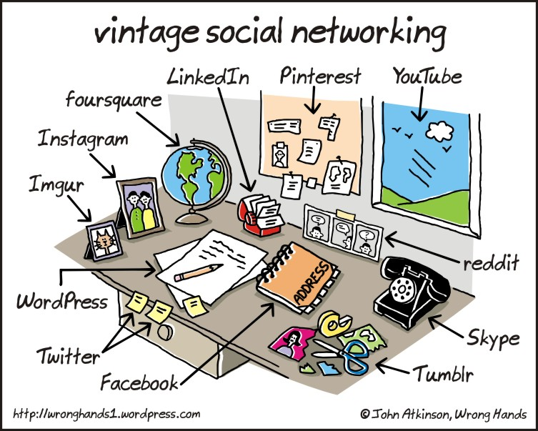
Web 2.0: The Social/Participatory Web
Wikis (Wikipedia)
YouTube
Blogs, Tumblr
Podcasts
Public forums
Facebook, LinkedIn
Pinterest
Twitter
Chat, IM, Skype
Virtual worlds
Games
Wordpress
Instagram, Imgur
reddit
Notes:
In the olden days we networked with these vintage means. Now we turn to the web and applications where new literacies are learned and practiced. In no particular order, here are just a few of the out-of-class use of students’ time – most of them requiring a certainly level of information literacy on the part of both the student and the teacher.

Slide 14
Reflecting on literacies/skills:
In pairs or groups of three, imagine a foreign language project based on new media resources and then identify the three most important skills or literacies associated with using the resources effectively to complete the project successfully.
Notes:
Think beyond the superficial technical operational level of skills
Think-pair-share; written exercise; collaborative learning group, student debate, reaction to video, role playing, partner exchange.

Slide 15
But my “digital native” students are already literate in the new media technologies, right?
Notes:
There are challenges for both teachers and learners. And, if anything, what our young people have is “electronic literacy” – familiarity with the technologies that surround them and the relatively superficial ability to make the technology work for them in ways they need at the moment.

Slide 16
Truths about Digital Natives
Digital divide: fundamental inequalities in young people’s access to new media technologies
Lack of reflection: although youth know how to use the resources, they do not actively reflect on their media experiences
Ethics challenge: ethical implications of new modes of communication are poorly understood by adults, so youth receive little or no guidance or supervision
(Jenkins et al., 2006)
Notes:
Jenkins refers to these as the core problems in teaching media literacy: the participation gap; the transparency problem and the ethics challenge
Lack of reflection: They don’t think about observing themselves as they use various technologies and how their experiences are mediated or shaped by and through any given medium
Children on their own cannot develop the ethical norms needed to cope with a complex and diverse social environment online.

Slide 17
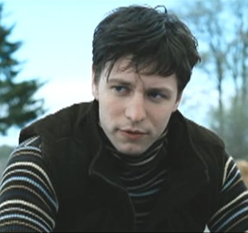
Russian Language in Context Advanced Russian Course
Project on Vladimir Zherebtsov
Popular Russian actor
Fan forum: http://zherebtsov.borda.ru/
Main tasks:
Visit website and gather personal information to answer questions.
Explore and find out information about the forum; register.
Students read recent postings for 3 discussion threads, write 1-2 posts per thread, monitor responses to their posts, document their forum activities.
Culminating reflections: differences between this forum and US forums; thoughts on the various tasks; what students learned/gained
Lesson author: Lyudmila Klimanova, FLARE Second Language Acquisition doctoral candidate, University of Iowa
Notes:
Language in Context: Practice in reading, writing, listening, and speaking using a variety of authentic materials from contemporary sources, such as on-line magazines and newspapers, films, interviews, and letters. Emphasis on building vocabulary and comprehension of complex grammatical structures. A one-week project on Vladimir Zherebtsov. Can work individually or in teams of 2 (but not more than 2) – and teams can’t compare their work. In class they watched and discussed an interview with the actor and watched a clip from his movie Вернуть Веру (Faith Restored). Also, during that week, in class they discussed (in Russian) technology and internet use (the chapter in V-puti: Russian Grammar in Context), worked on new vocabulary in conjunction with this topic, had role plays (e.g. "your computer is out of order, explain the problem, and ask a friend to help you fix it"). We also watched a video clip and discussed "online dating".
The promise of this is engaging in authentic interaction with members of the other culture; communication across linguistic, geographical and cultural borders.
The problem is that this is not as easy to implement as we would like.

Slide 18
Up and Down Sides
Students explore/participate in authentic fan forum
Culturally authentic environment
Authentic language use
Interaction with Russian native speakers
Exposure to Russian pop culture
Students not accepted/acknowledged (foreigners!)
Some students not interested/not engaged
Difficulty in tracking participation (teacher)
Notes:
There are many issues to consider: differences in cultural behaviors/practices with technology, participation norms (regulation of the discussion), identities. Among the problems that arose, Lyudmila reported that the Forum monitor became alarmed when this bunch of unknowns showed up. (Their Russian was impeccable, but they weren't really accepted. – Needed a different approach to becoming a participant in the community. Also, it was not easy for the teacher to follow everything the students did in the forum. There was not easy way to search for them, so she had to scan through everything to find their postings and also rely on their reports of their activities. And, in the final analysis, not all students were keen about this assignment and virtually none of them stayed with the forum after the assignment was over.
Cultural literacy skills more important here than language skills. It’s like when you’re the new kid on the playground and you’re not quite sure how to join in the games with the other kids.

Slide 19
The Utopian discourse of the borderless world predicts that ease of communication through shared technologies will erase cultural difference. Studying intercultural Internet exchanges gives the lie to this myth.
(Hanna and de Nooy, 2009)

Slide 20
New Literacies New social skills, cultural competencies
The new media literacies should be seen as social skills, as ways of interacting within a larger community, and not simply an individualized skill to be used for personal expression. … Youth need skills for working within social networks, for pooling knowledge within a collective intelligence, for negotiating across cultural differences that shape the governing assumptions in different communities and for reconciling bits of data to form a coherent picture of the world around them.
(Jenkins et al. 2006, p. 20-21)

Slide 21
Reflecting on teaching/learning literacy skills:
What kinds of activities or active learning strategies can we use to build L2 literacy skills for our language students?
Notes:
In his article “Understanding Digital Children,” Ian Jukes talks about a “21st Century kind of content”: critical thinking, problem solving and the structured teaching of process skills, combined with personal life skills, interpersonal life skills, team skills, communications skills, information fluency skills, technology fluency skills, visual fluency skills, biotechnology and bioethics skills. We can’t do it all – we have to get rid of some of what is not as important as it was when we went to school to make room for teaching our digital native learners the skills they need for their future lives. (pp. Palfrey and Gasser echo this sentiment in Born Digital: Our children find information in digital formats and are processing it in ways that those who came before them could only have imagined. This information is sometimes surrounded with far less context than in the past, while at other times, it is surrounded by far more. Our challenge is to help them make sense of these new contexts and new meanings, and to think synthetically and critically, rather than letting them lose their way. (p. 253)

Slide 22
Closing thought…
Language is changing around us, and so is our culture of literacy, but that is what languages and cultures always do. ... In language teaching, an emphasis on analysis and thinking in a literacy-based approach can help prepare our students not only to use, but also to assess critically, new multimodal forms of expression as they continue to evolve.
Richard Kern (2006)

