Slide 1
A Combinatorial Perspective to Vortex Dynamic Problems
By Nitesh Mathur
Under the Kind Guidance of Dr. Kevin O’ Neil

Slide 2
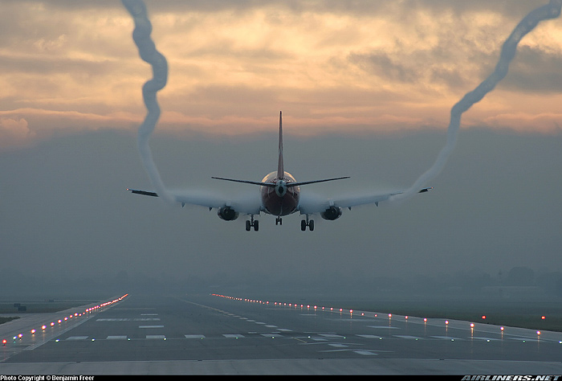
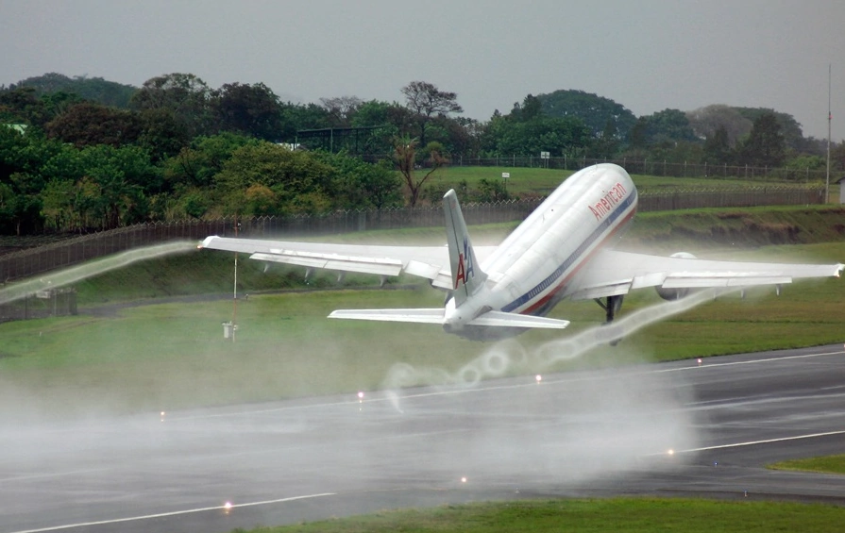
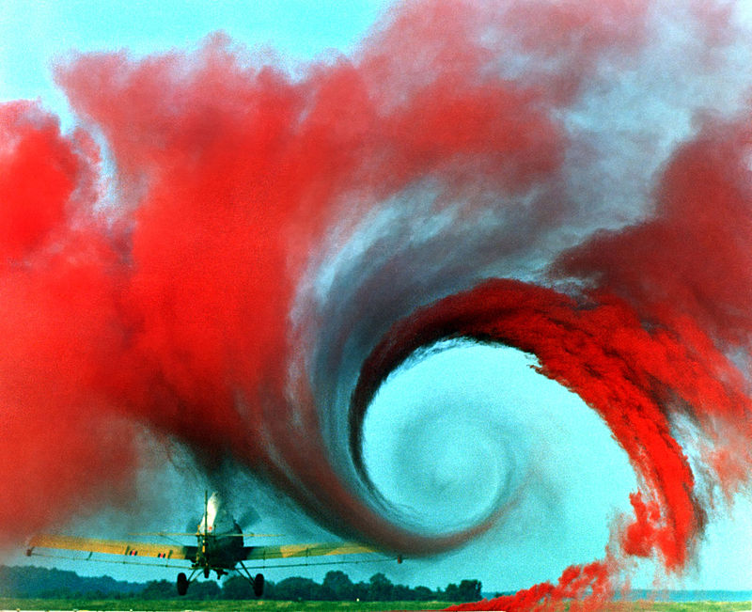
What is a Vortex?

Slide 3
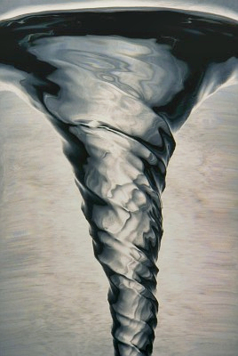
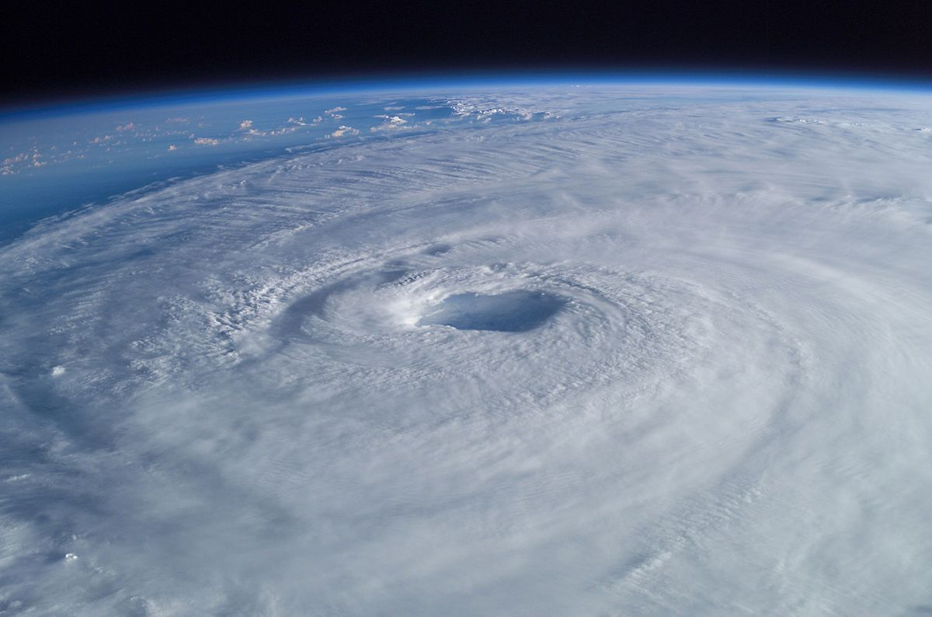
What is a Vortex? (Continued)
A vortex is a region in a fluid in which the flow revolves around an axis.

Slide 4
Quick History
Originates from Newton’s n-body problem
Lord Kelvin (1875) – studied vortex configurations that move without alteration of form (relative equilibria)
Kirchoff extended problem from point masses to point vortices
Many techniques utilized in the n-body problem is used in the n-vortex problem

Slide 5
Why Is it Important ?
Well Known Problem
Smale’s “Problems for the Next Century” - Problem #6
Finiteness of Relative Equilibria in Celestial Mechanics
Numerous Physical applications/ Numerical Experimentations
Theoretical Background Lacking

Slide 6
Relative Equilibria
A relative equilibrium is a special configuration of vortices that rigidly rotates about its center
Uniform Rotation and Translation
Relative Equilibria of the 3-Body Problem is Well Known

Slide 7
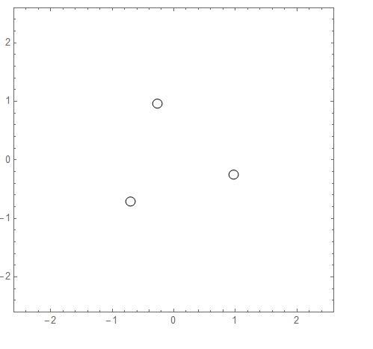
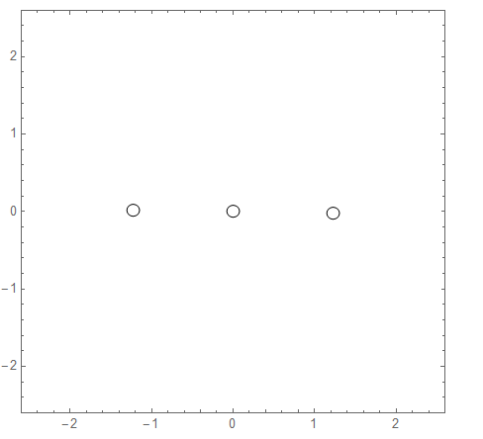
Relative Equilibria – 3 Vortex Problem (Newton’s Method)

Slide 8
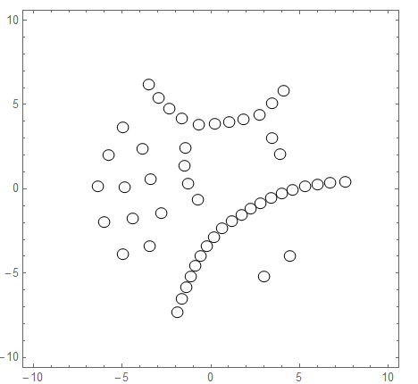
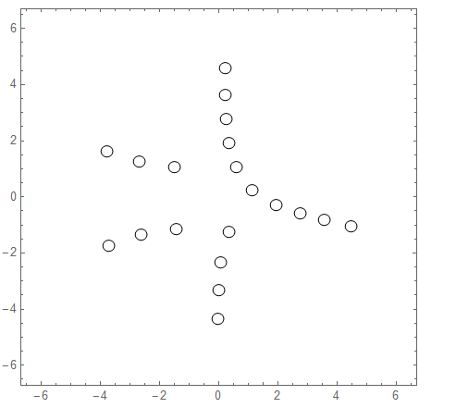
Relative Equilibria: n >= 20

Slide 9
What has been done so far?
Widely Held Conjecture:
There are only a finite number of unique relative equilibria
Finiteness Known for Completely Stationary vortex configurations
Open Problem for Dynamic Vortex Configurations
Problem Solved for n <= 4, and special cases up to n = 7, but not for all n

Slide 10
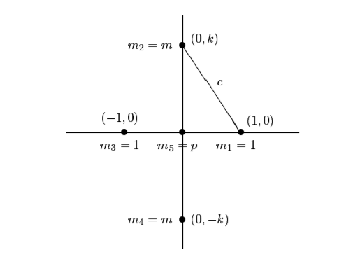
Roberts’ Continuum
Gareth Roberts’ 1999 Paper
n = 5
Continuum Found with negative circulations
For Point vortices, this occurs with $Γ$={1,1,1,1-1/2}
Question Arises: Are there other continuums out there?

Slide 11
Mathematical Stuff
$u−iv=\frac{1}{2πi}\sum{\frac{Γ_j}{z−z_{j}}}$
$Γ_{j}$ represents the strength of the point vortex
$z_{j}$ represents distinct points in the complex plane
Interpretation: Velocity of the point vortex at $z_{j}$ is the sum of the velocities induced by other vortices

Slide 12
Equations for Relative Equilibria
$\sum{\frac{Γ_k}{z_{j}−z_k}−2 π \left(\overline{z}\right)}ω=0$
where $ω$ is a constant that represents the rotation rate.
Permutation: ${\overline{z}}_{j}=z_{π\left(j\right)}$, $Γ_{j}=Γ_{π\left(j\right)}$
Interpretation: All $z_{j}$ either real or come in complex conjugate pairs

Slide 13
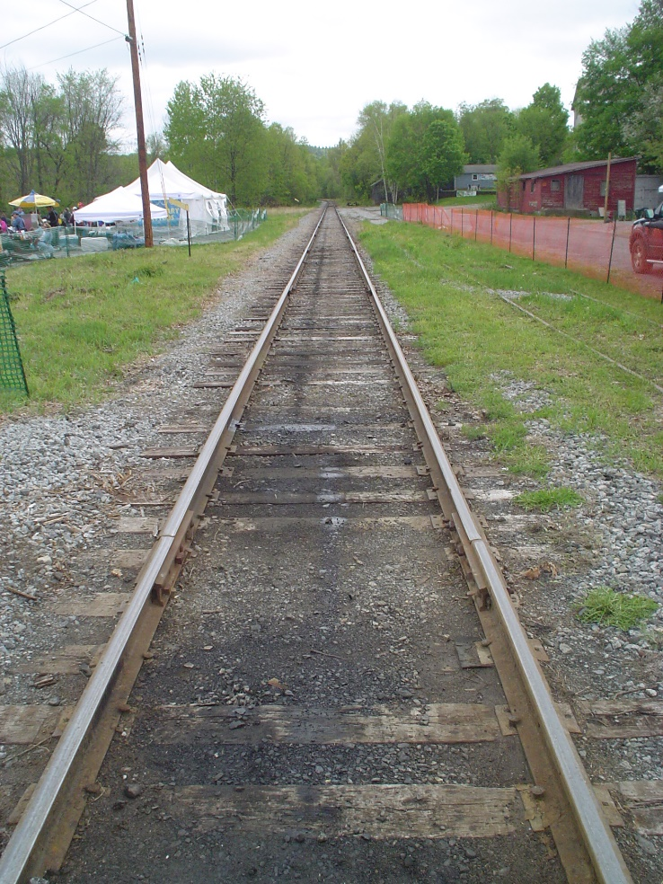
Affine Vs Projective Space
An Affine Plane Can be Used to construct a Projective a Plane by Adding a ‘Line at Infinity’
Each family of solutions in the Affine Plane can be represented by a single point in the Projective Plane.

Slide 14
Goals
Solve Problems on Mathematica
Try to Find Patterns in solutions of the Projective Space in order to discover a pattern in the Affine Plane
Find another Continuum

Slide 15
Work Summary
Converted the equations into Mathematica Code to understand the relationship between theoretical background/ numerical results
Newton Method’s employed to visualize Relative Equilibria for higher number of vortices
Generated new code for the Projective Plane using Set Partitions
Interpreted the number of solutions in the Projective Space to find a connection for the number of solutions in the Affine Plane
Randomized Gamma Values, Permutations, and Set Partitions in order to discover a continuum

Slide 16
Set Partitions – Points at Infinity

Slide 17
Continuum Experimentation
Roberts’ Continuum resulted with this infinite solution:
Erroneous Solutions Produced Similar Output

Slide 18
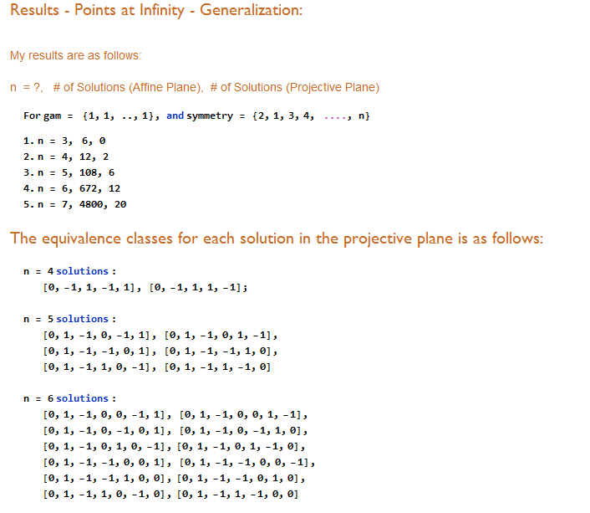
Combinatorics – Sample Work

Slide 19
Continued (Forming Conjectures)

Slide 20
Continued (Derivation)

Slide 21
Interesting Results/ Conclusion
From time to time, Mathematica produced infinite results but they were either trivial solutions or erroneous solutions
A continuum might still exist (Found several ways how NOT to find a continuum)
Several interesting combinatoric patterns were found but how the Projective Plane solutions relate to the Affine Plane is still a mystery.

Slide 22
Problems Encountered
Nsolve()
Finds numerical approximation to system of equations
Problem: Versions 9 and 11 were giving us two separate answers
Would leave computer working for 8 hours, and it would produce incorrect results
To quote Dr. O’Neil: “I have just worked for two hours and I am completely baffled…I have looked at it six different ways and still don’t understand what’s going on. Mathematica is giving us ‘garbage answers’ and thinks they are correct’ -7/18/2017

Slide 23
Current Work
Dr. Kevin O’Neil (TU)
Dr. Gareth Roberts (College of Holy Cross)
Hampton and Moeckel (University of Minnesota)
Albouy and Kaloshin (University of Maryland)
Faugere, Araf Hassan, Cheung among others

Slide 24
Thank You
Thank you to Dr. O’Neil for being my mentor for the past three years
Thank you Dr. Charleston for TURC and other opportunities
Thank you all for Listening

Slide 25
The End
Questions?

