Slide 1
Game Theory
By Nitesh Mathur, Xian Wang

Slide 2
Part I
Introduction to Game Theory
by Xian Wang

Slide 3
Basics of Game Theory
Game: Any set of circumstances that has a result dependent on the actions of two or more decision makers
Players: A strategic decision maker within the context of the game
Strategy: A complete plan of action a player will take given the set of circumstances that might arise within the game
Payoff: The payout a player receives from arriving at a particular outcome.

Slide 4
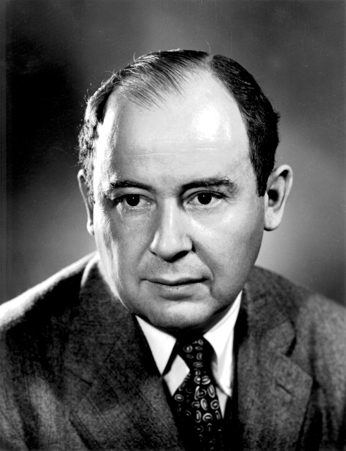
What is game theory and its origin?
Game Theory is “the study of mathematical models of conflict and cooperation between intelligent rational decision-makers”
Modern game theory began with the idea regarding the existence of mixed-strategy equilibria in two-person zero-sum games and its proof by John von Neumann
Types of Games
Cooperative / Non-cooperative Game
Symmetric / Asymmetric Game
Simultaneous / Sequential Game
etc.

Slide 5
What is Prisoner’s Dilemma?
Two members of a criminal gang are arrested and imprisoned. The policeman lack sufficient evidence to convict the pair on the principal charge. They hope to get both sentenced to a year in prison on a lesser charge. Simultaneously, the policeman offer each prisoner a bargain. Each prisoner is given the opportunity either to: betray the other by testifying that the other committed the crime, or to cooperate with the other by remaining silent.
Choice in Prisoner’s Dilemma.
The offer is:
If A and B each betray the other, each of them serves 10 years in prison
If A betrays B but B remains silent, A will be set free and B will serve 20 years in prison (and vice versa)
If A and B both remain silent, both of them will only serve 5 year in prison (on the lesser charge)

Slide 6
B A | cheat | Not cheat
cheat | -10 -10 | -20 0
Not cheat | 0 -20 | -5 -5
Then we find there is a Dominant Strategy

Slide 7
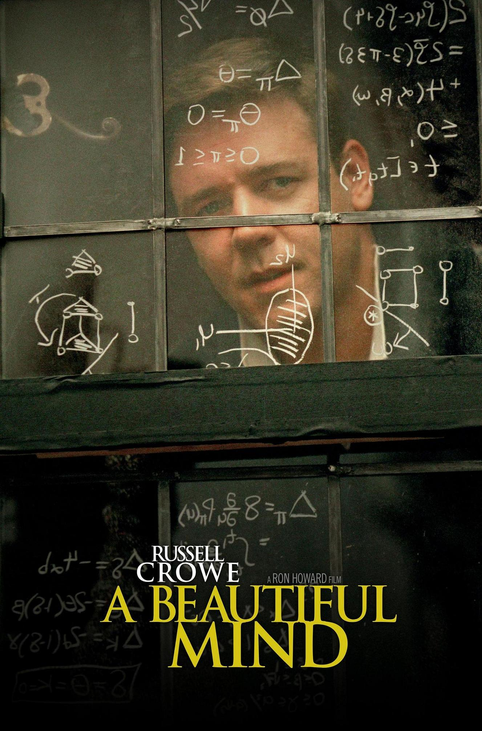
What is the Nash Equilibrium?
Nash Equilibrium is a term that used in game theory to describe a balance where each player's strategy is best given the strategies of all other players. No player in the game would take a different action as long as every other player remains the same. When players are at a Nash Equilibrium they do not want to move because they will be worse off.

Slide 8
The relation between Nash Equilibrium and Dominant Strategies
A and B play a self-made game. A can go up or down, B can go left, middle and right.
B A | LEFT | MIDDLE | RIGHT
UP | 0 2 | 4 2 | 2 0
DOWN | 5 0 | 2 0 | 0 4

Slide 9
Two drivers are traveling towards each other on a road. Should they drive on the left or the right side? They don't want to wreck
B A | Left | Right
Left | 1 1 | -1 -1
Right | -1 -1 | 2 2

Slide 10
Part II
Applications of Game Theory
By Nitesh Mathur

Slide 11
Scenarios in Economics
How companies respond to competitor’s prices
Examples
Players - Two Companies (New Business Vs. Old Monopoly)
Actions - What strategies should be utilized?
Decision - Make new product or copy?
To Advertise or Not Advertise, that is the question

Slide 12
Ethics and Morality
Functionalism
Classic Example:
2 Soldiers- Operate a Strategically Important Post or Flee?
Conclusion (By Traditional Game Theory): Both would do better by fleeing
Morality: Function of Morality is to Prevent Function of Rationality (Chained to guns)
Bargaining Theory and Contractarianism
“Constrained maximization” by Gauthier (1986) - Morals by Agreement
Conclusion: Moral Norms acceptable if no other alternative where everyone is better off

Slide 13
Applications to Computer Science
Computer Science and Game Theory: A Brief Survey
Byzantine Problem
Each general can attack or retreat
Goal: All non-faulty generals reach the same decision
Computers - generals, digital communication systems - messengers
Computing Nash Equilibrium
Combinatorial Auctions
Distributed Computing
Learning in Games

Slide 14
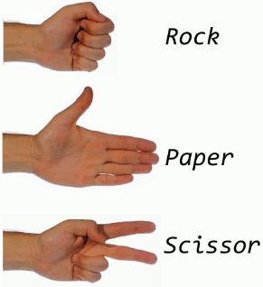
Other Examples of Game Theory
Evolutionary Game Theory in Biology
Altruism
Rock-Paper-Scissors
Tactical Voting
Example : 2000 Election
Political Science
Fair Division
War Bargaining

Slide 15
Joker’s Social Experiment
Prisoner’s Dilemma employed in The Dark Knight
Prisoners and Citizens are on two different ferries containing explosives
Joker gives both the following options:
Detonate the explosive on the other ship and survive
Die

Slide 16
Cite Sources in MLA
Alexrod, Robert. “Effective Choice in the Prisoner’s Dilemma.” The Journal of Conflict Resolutoin 24.1(1980): 3-25 JSTOR URL=<https://www.jstor.org/stable/173932?seq=1#page_scan_tab_contents>. Accessed 15 Feb. 2018.
Halpern, Joseph Y. “Computer Science and Game Theory”. The New Palgrave Dictionary of Economics, 2nd edn. (2008), S.N. Durlauf and L.E. Blume, eds. URL=<http.//www.cs.cornell.edu/home/halpern>. Accessed 17 February 2018.
Myerson, Roger B. Game Theory: Analysis of Conflict(1991). Harvard University Press, URk=<https://books.google.com/books?id=E8WQFRCsNr0C&printsec=find&pg=PR7#v=onepage&q&f=false>, Accessed 22 February 2018
Veerbeek, Bruno and Morris, Christopher. “Game Theory and Ethics. The Stanford Encylopedia of Philosophy(Winter 2017 Edition), Edward N. Zalta (ed.) URL = <https://plato.stanford. edu/archives/win2017/entries/game-ethics>. Accessed 17 February 2018.

Slide 17
The End!!!!!

