Slide 1
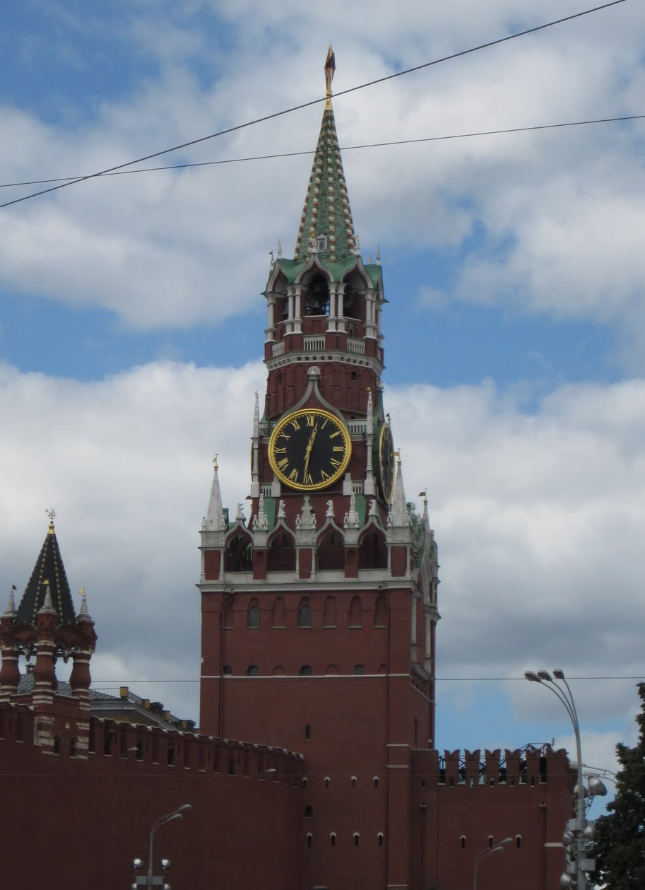
Достопримечательности Москвы
You're the guide!

Slide 2
Tour of Moscow
You have been living in Moscow for six months, and a friend from Ekaterinburg is coming to visit.
You want to show off your new home town…you have some studying to do!

Slide 3
Cram!
First of all, you might want to review some critical phrases for giving a tour. Use this Quizlet set, where you can check basic phrases.

Slide 4
Next step...
Next, you travel around with a Russian guide, taking notes on what she says.

Slide 5
Jeopardy
Then you play a game to check your knowledge of Moscow.

Slide 6
Your turn!
Finally, you use the pictures you took on the tour and practice talking about the different locations.
Consider recording your voice on VoiceThread, Voki, or a GarageBand or Audacity podcast to practice just one more time before your friend arrives.
Удачи!

Slide 7
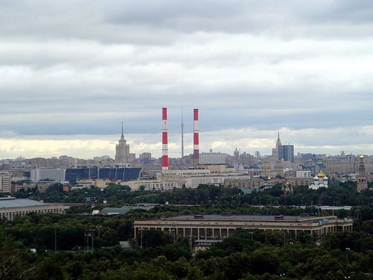
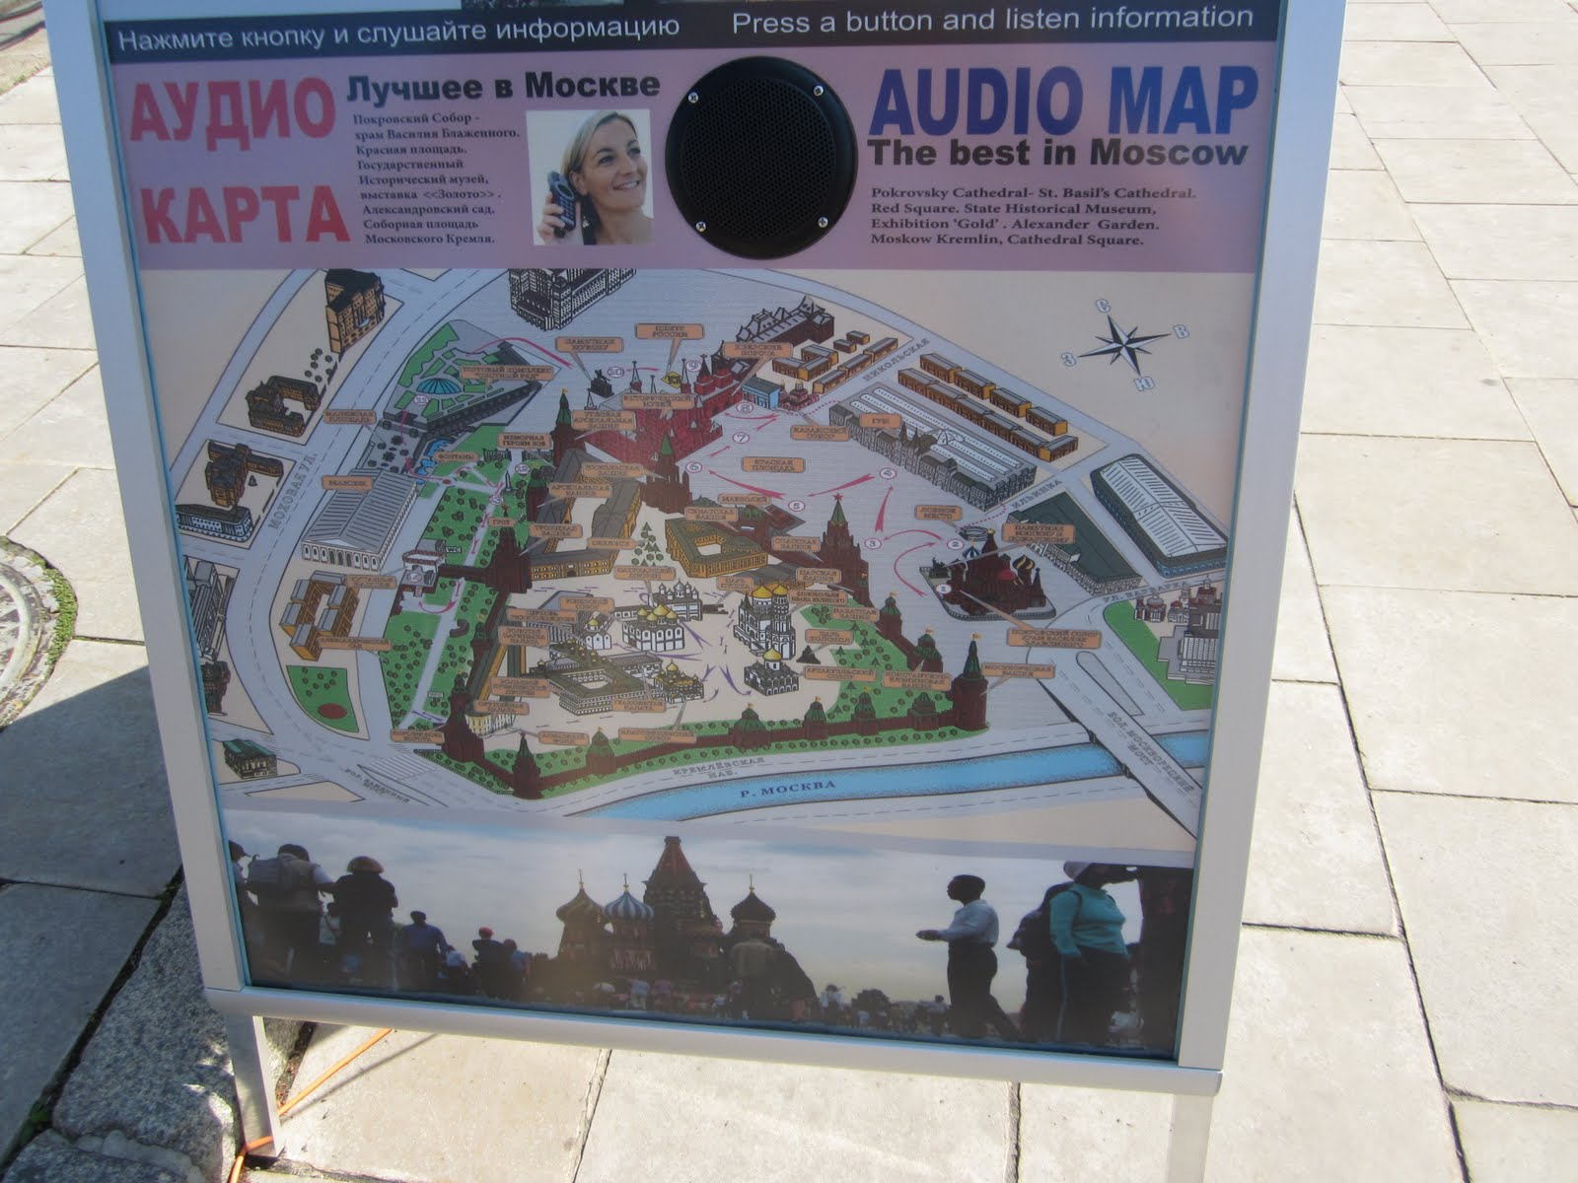
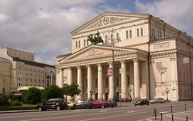
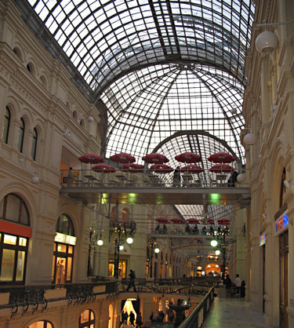
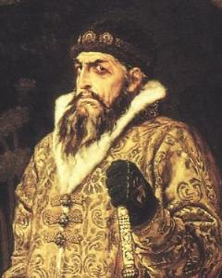
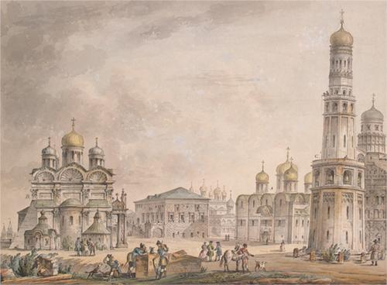
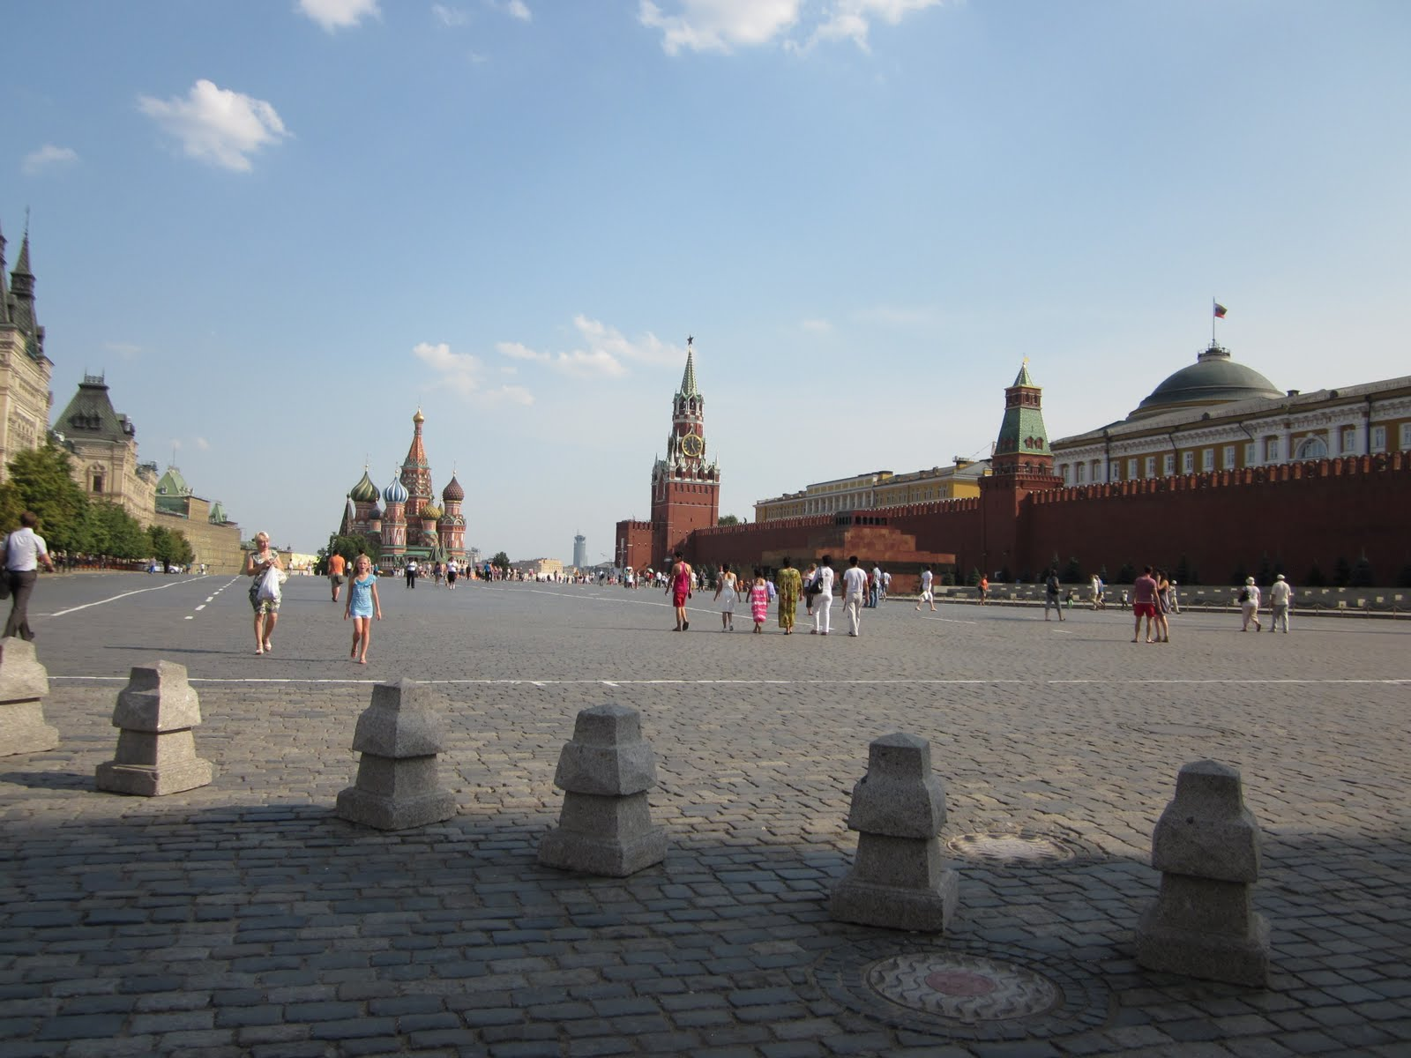
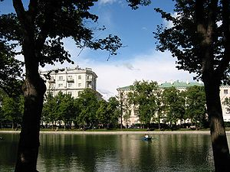
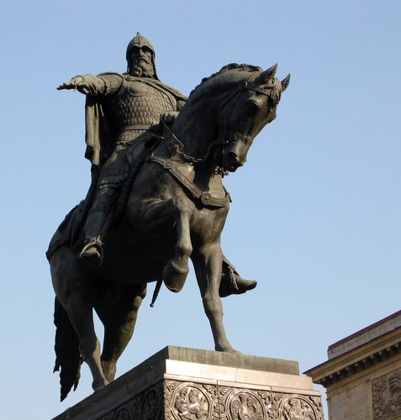
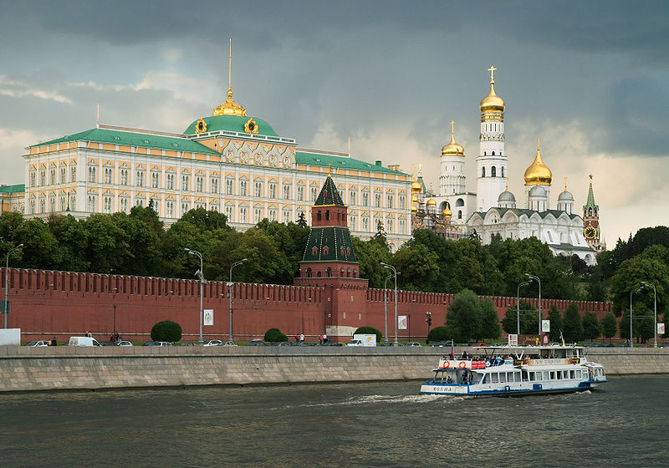
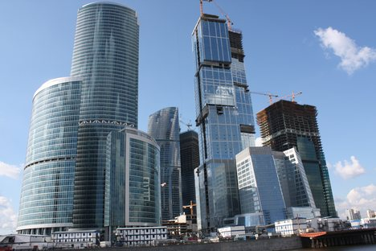
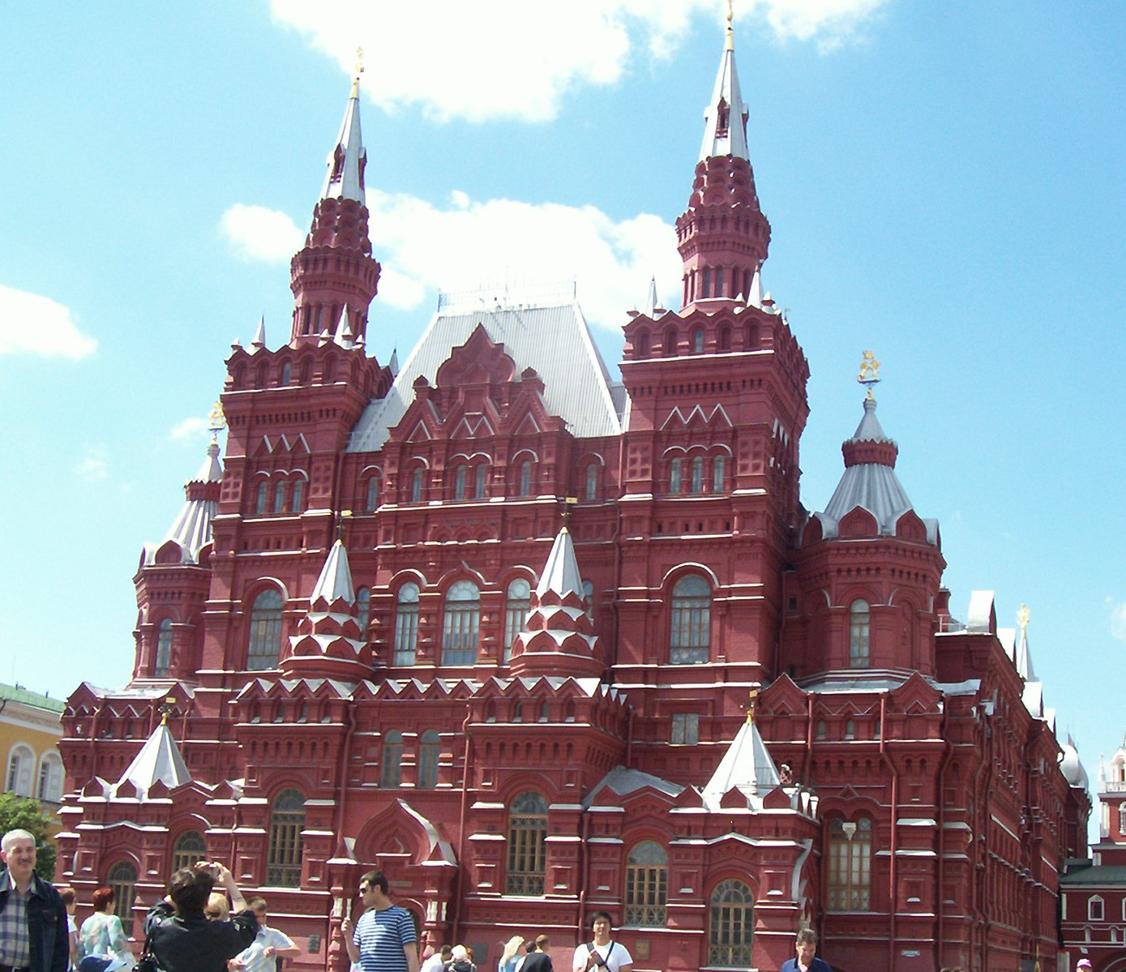
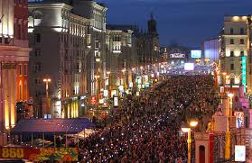
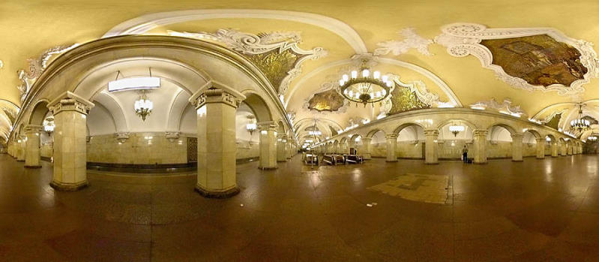
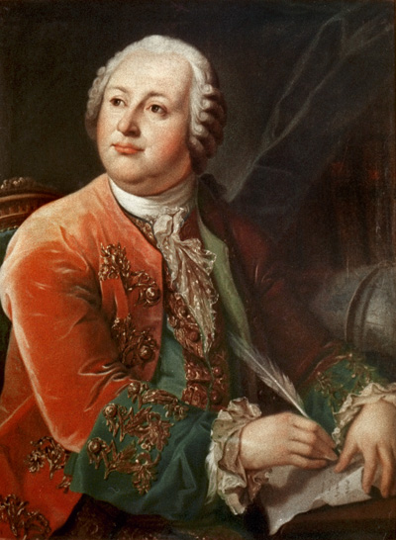
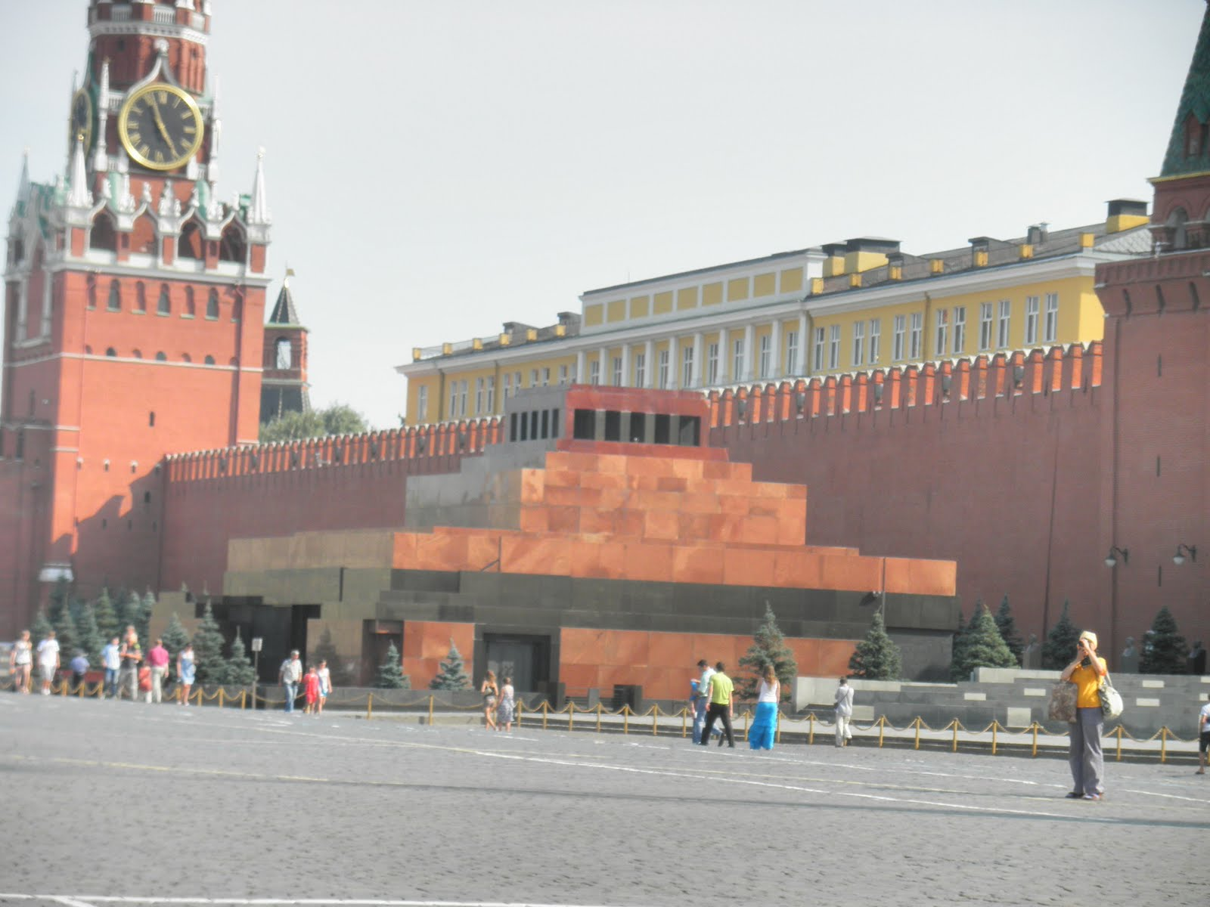
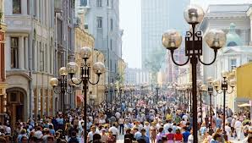
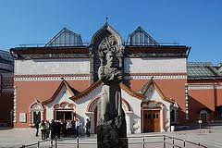
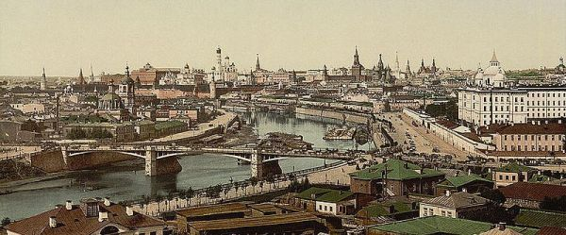
Your pictures:

Slide 8
Picture credits
Picture credits:
Petersen family,
public domain photos from Wikipedia,
and
http://ookaboo.com/o/pictures/topic/30588/Moscow (ookaboo: free pictures of everything on earth

