Slide 1
Where should I stay?
Practice vocabulary that you will need to explore Russian hostel sites.

Slide 2
Learn!
On the next slides are links to practice two sets of vocabulary you might find on a Russian hostel site.

Slide 3
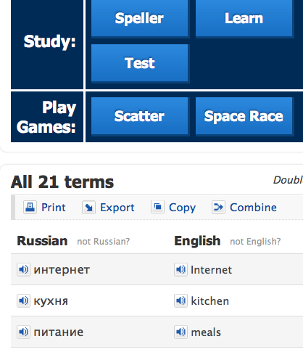
About Quizlet
The links will take you to Quizlet.com, where you can
test yourself
play games
print a vocab list
listen to audio

Slide 4
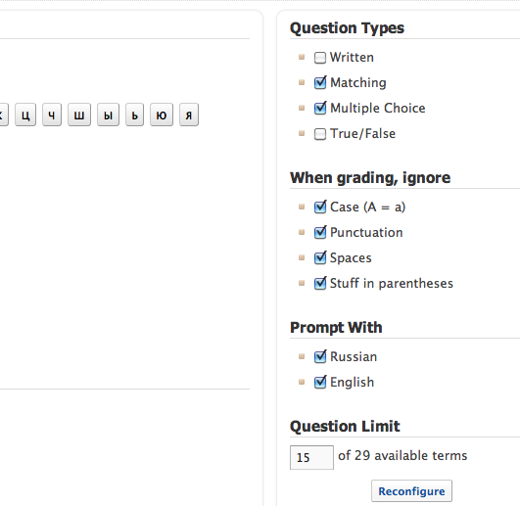
Set the test
Set the item type
Set the grading parameters
Set the prompts
Set the # of questions

Slide 5
What do I do first?
Read and listen to the vocabulary
Print out the list
Play the games
Test
Or the opposite way–it's up to you!

Slide 6
Hostels: necessary vocabulary
Here are the links to Quizlet exercises to review vocabulary you'll need for Russian hostel websites in lessons to come. Удачи!
Cognates
(international words Russian-English)
High-frequency vocabulary

Slide 7
For the teacher
Exercises attached to this PowerPoint are meant to give students a quick overview of critical vocabulary they will find on a Russian hostel site. Students can email screen shots of their test grades on Quizlet to their teachers, and teachers may set up a class account to view scores on the site.

