Slide 1
Match The Major

Slide 2
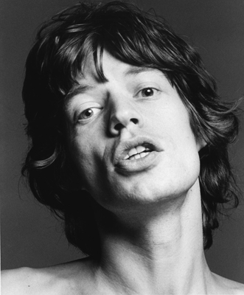
Mick Jagger
The Rolling Stones
Economics

Slide 3
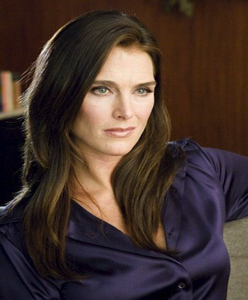
Brooke Shields
Actress
French Lit

Slide 4
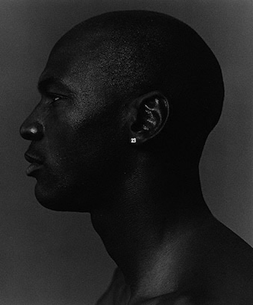
Michael Jordan
NBA Hall of Famer
Mathematics

Slide 5
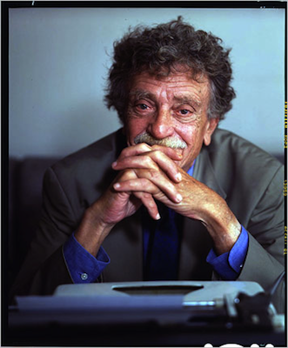
Kurt Vonnegut
Author
Anthropology

Slide 6
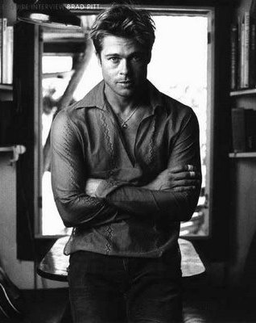
Brad Pitt
Actor
Journalism

Slide 7
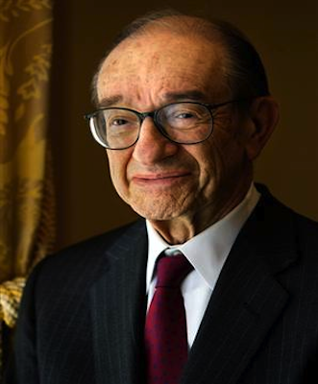
Alan Greenspan
Economist
Music

Slide 8
Paul Newman - Majored in economics Thurgood Marshall - Studied dentistry Oprah Winfrey - Majored in Speech/Drama Ashton Kutcher - Majored in biochemical engineering (University of Iowa)

